Slide 1
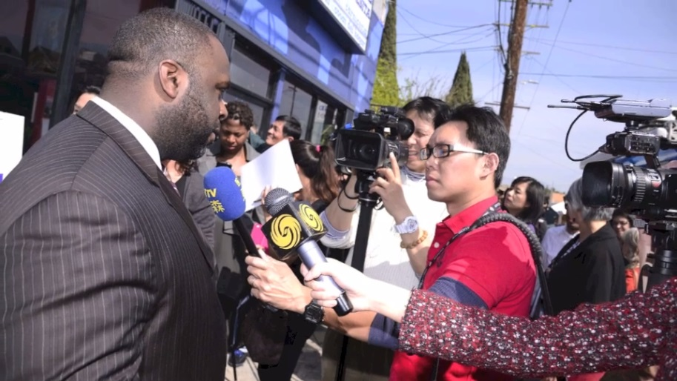
Turning Statewide Data Collection into a Media Frenzy: the Role of Data Visualization
Turning Statewide Data Collection into a Media Frenzy: the Role of Data Visualization
Notes:
Thank you for joining us for our presentation “Turning Statewide Data Collection into a Media Frenzy: the Role of Data Visualization”.
When engaging in advocacy work, generating media coverage about program findings is crucial for promoting community interest in the issue. Leveraging data into media coverage doesn't just happen, though.

Slide 2
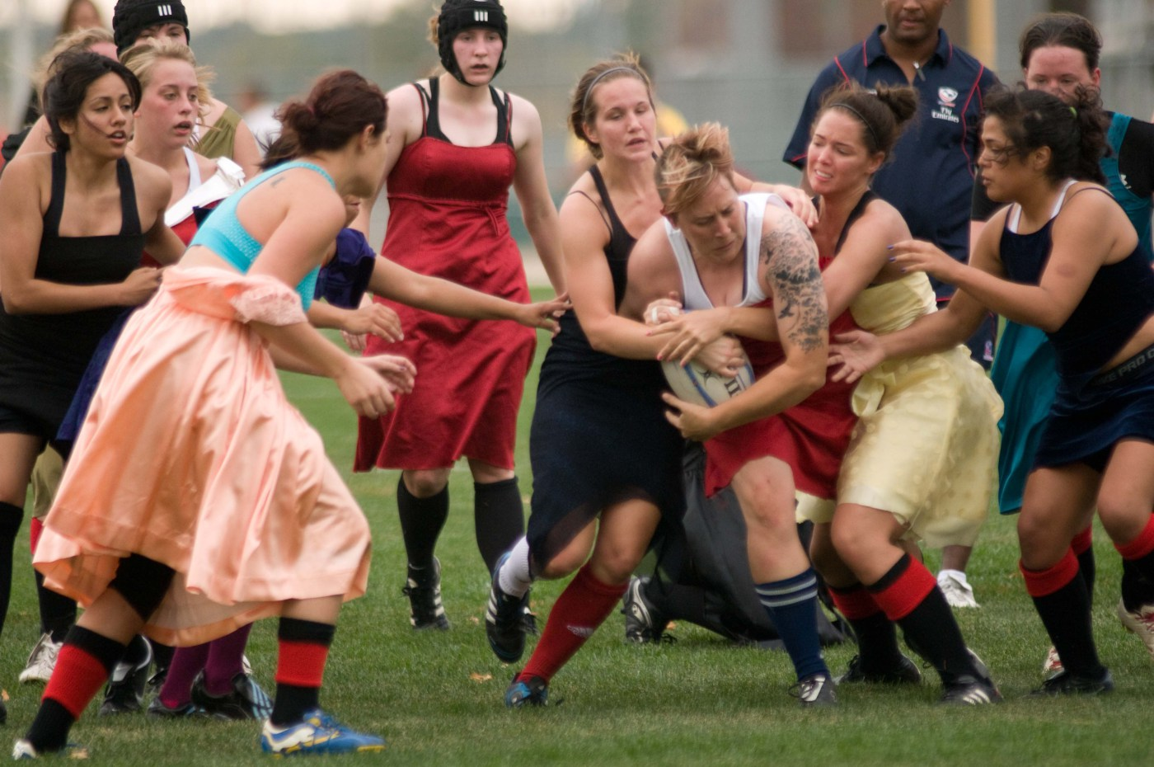
Grab Reader Interest
Notes:
http://cornfedsports.wordpress.com/tag/womens-rugby/#jp-carousel-824
Programs that do this work need to translate evaluation findings into eye-catching representations that grab readers’ interest and tell a compelling story about the need for policy action.

Slide 3
Transformers
Notes:
Amazon.com
Today we’ll be telling you the story of how 61 city and county health departments in California, with the help of data visualization, transformed…

Slide 4
Notes:
Observational data from over 7,300 stores across the state into…

Slide 5
Notes:
over 240 pieces of media coverage.

Slide 8
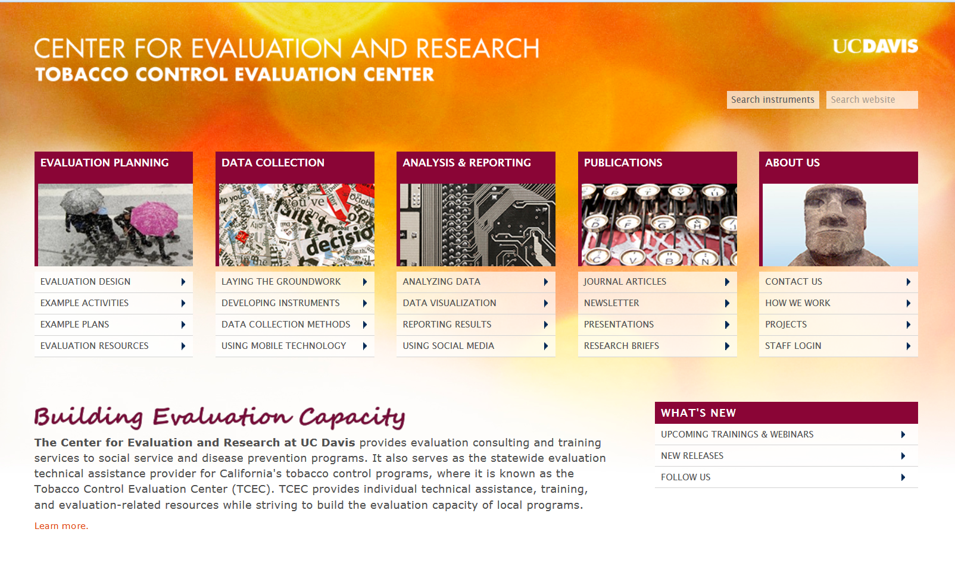
Notes:
I’m Robin Kipke and this is my colleague Catherine Dizon and we are associates at the Tobacco Control Evaluation Center at the University of CA, Davis. As the evaluation capacity building center for the CA Tobacco Control Program, our team trained projects for this statewide data collection effort, provided technical assistance in the field, and offered guidance about writing up and representing the data to various audiences.

Slide 9
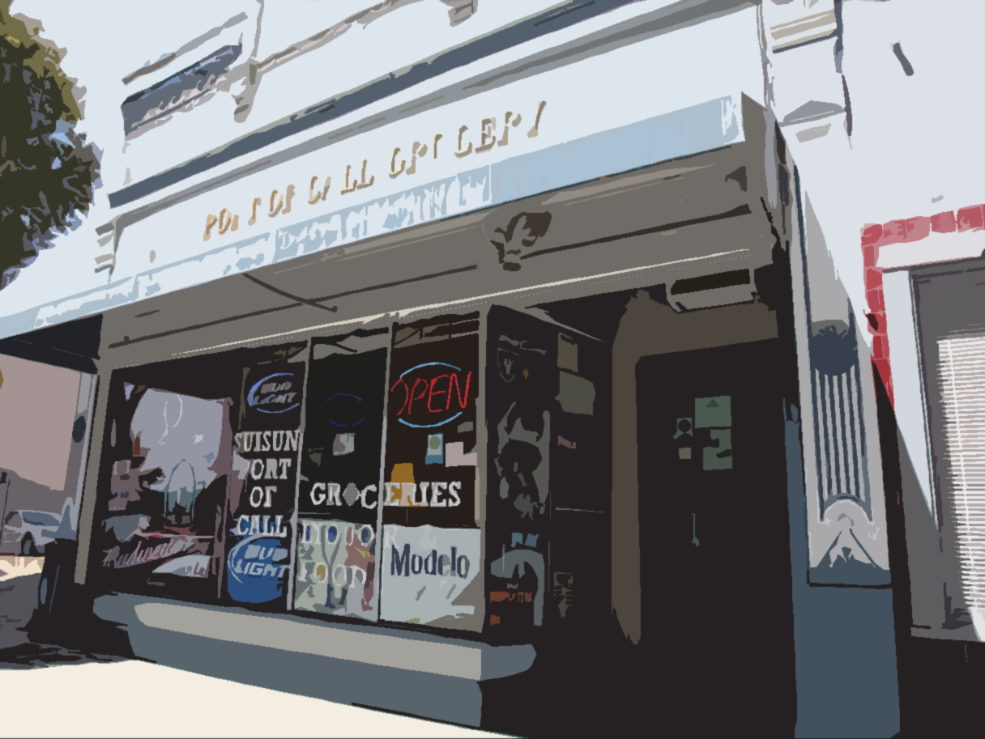
Observations of Local Retail Environments
Notes:
Here’s how our story began….In an effort to improve the health of local communities, the CA Tobacco Control Program which funds these projects sought to document the availability, marketing and pricing of…

Slide 10
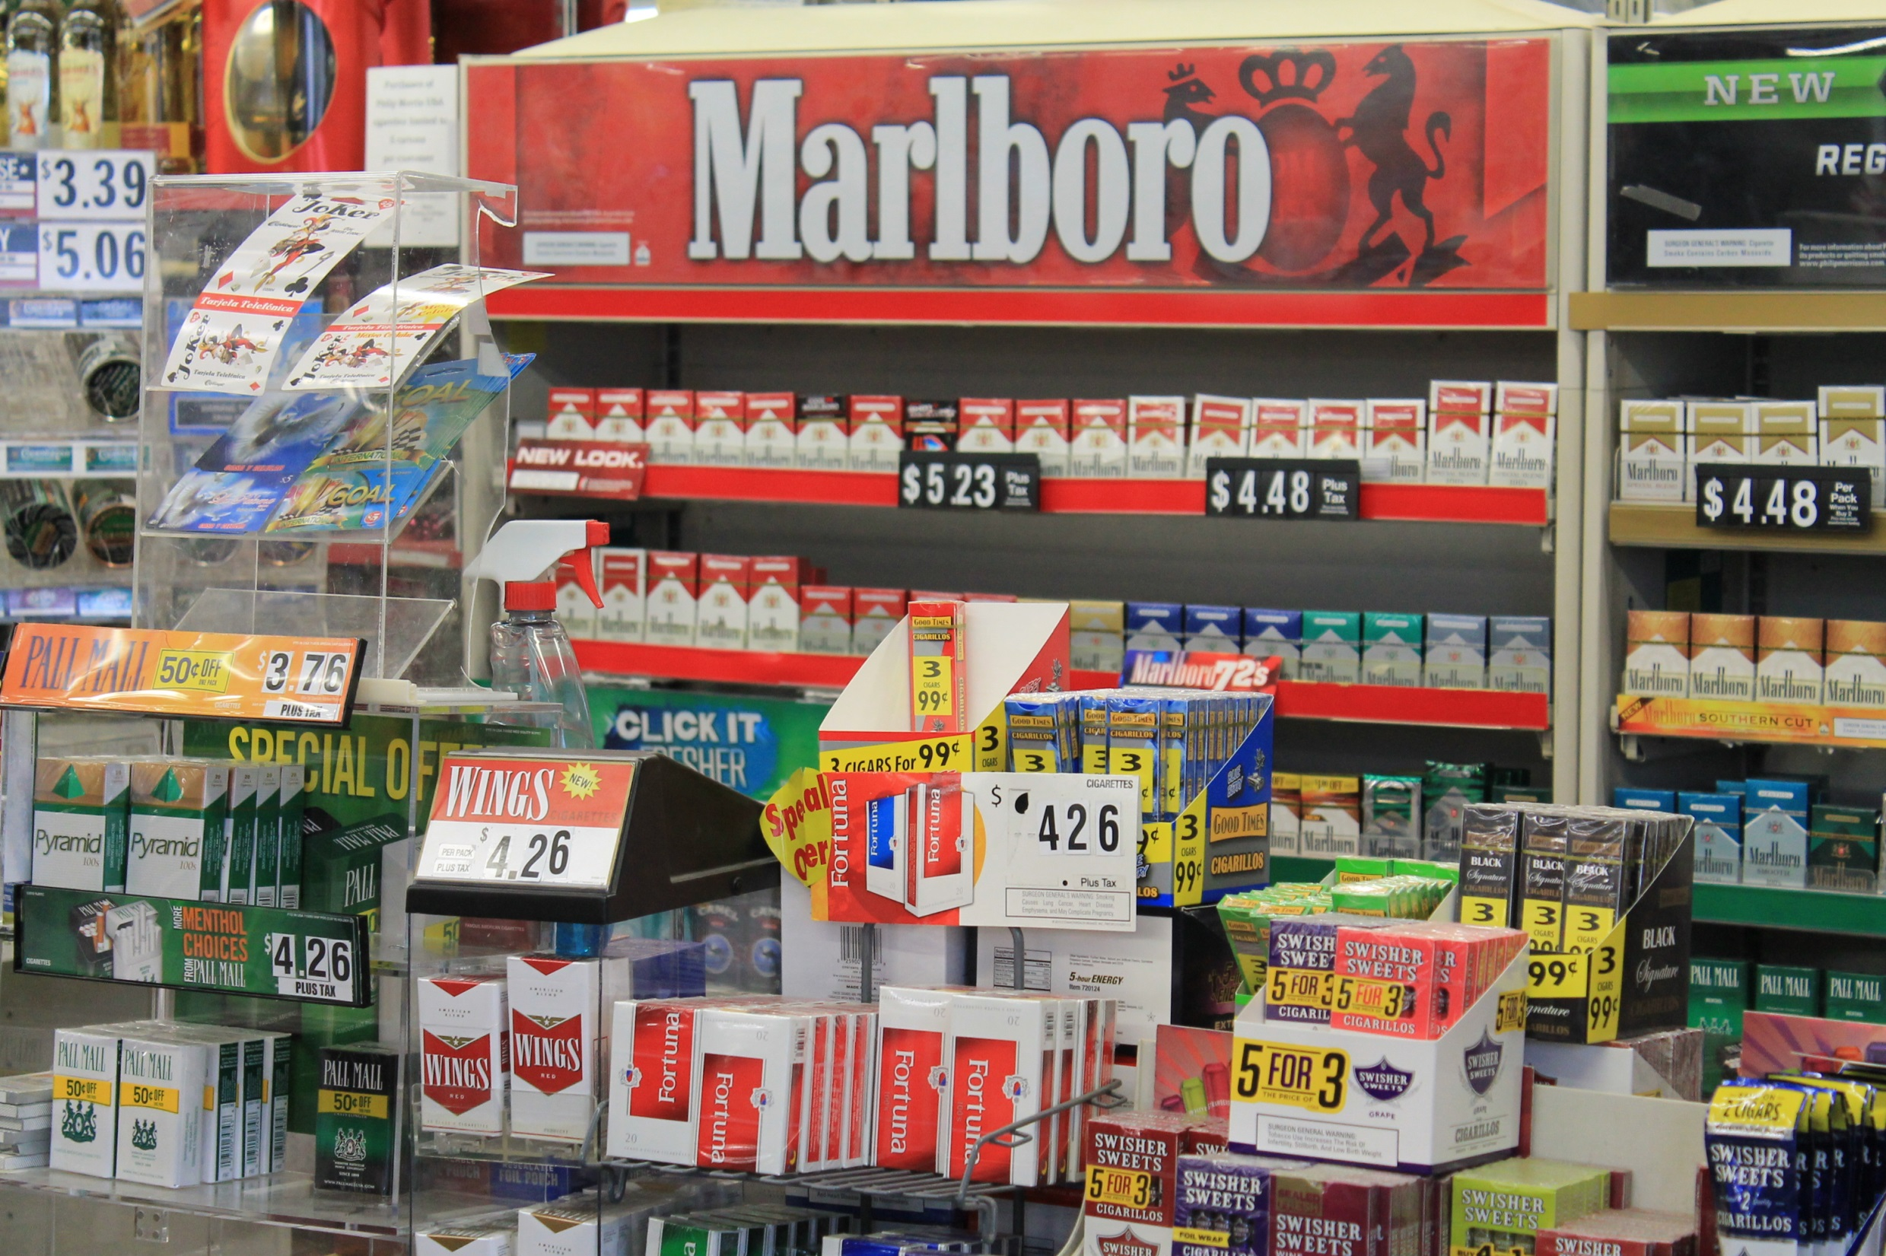
Notes:
Tobacco products

Slide 11
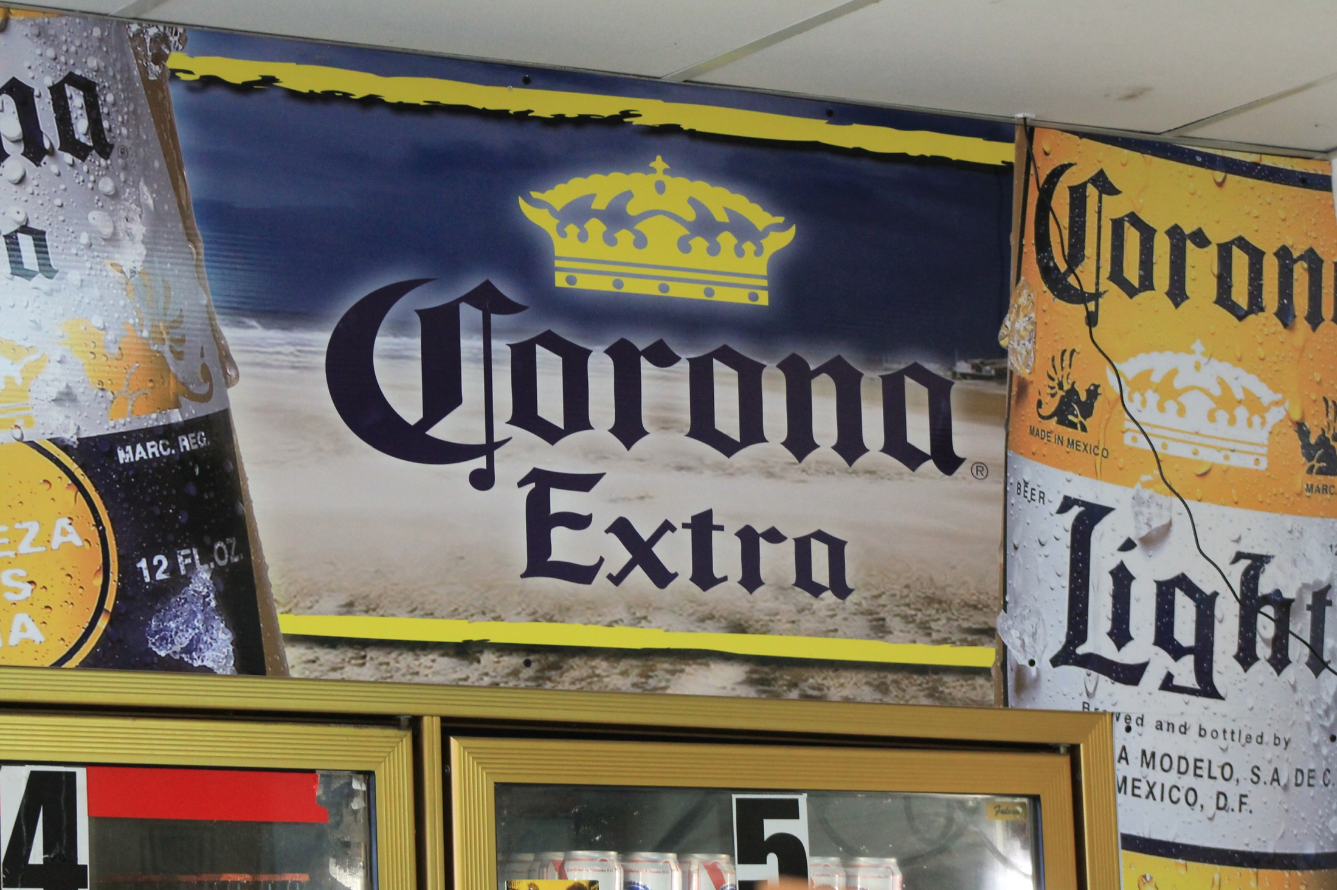
Notes:
Alcoholic beverages

Slide 12
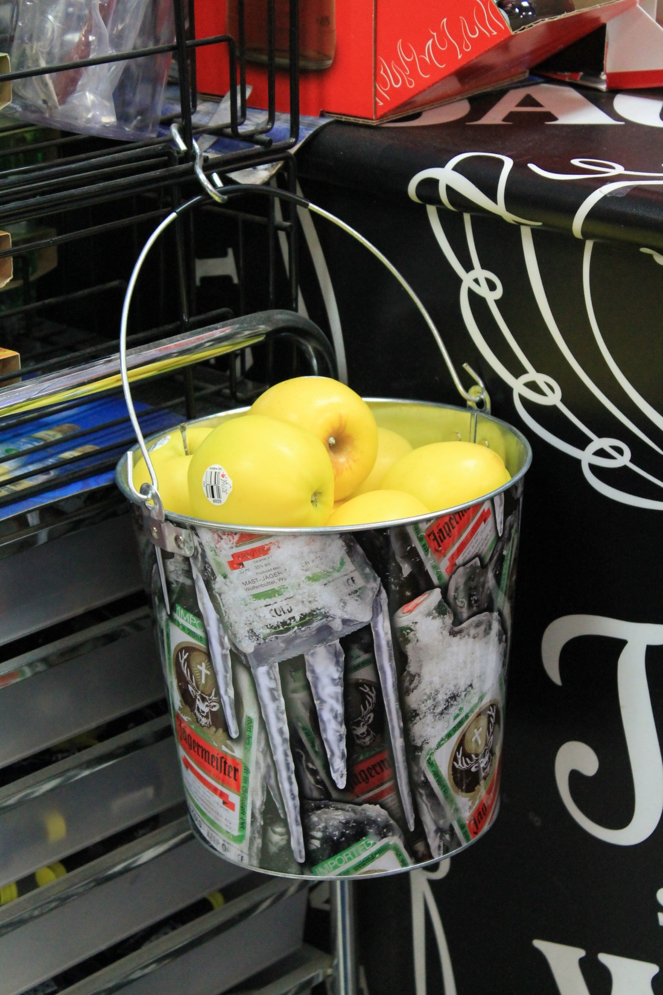
Food Deserts
Notes:
And the presence or absence of healthy foods in every county. Each health department collected data on anywhere from 40 to 154 different variables.

Slide 13
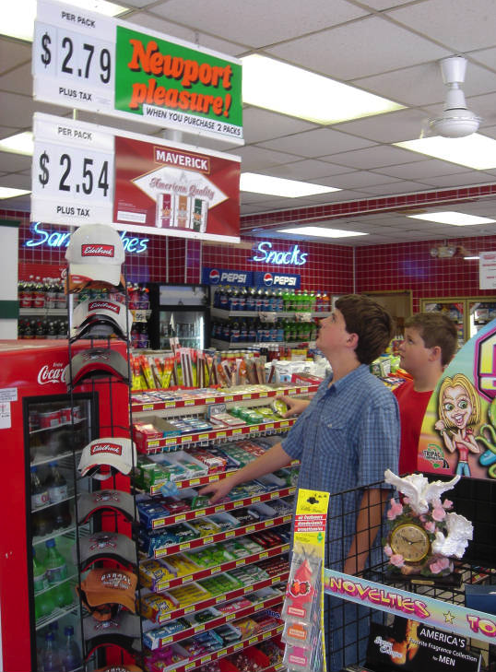
Protect Youth from Exposure
Notes:
Armed with this data, each project is now advocating for local level policies that will help protect youth from exposure to these unhealthy products and marketing tactics.

Slide 14
Notes:
Once all the data was collected, the challenge was: how to raise community awareness and interest in these issues.

Slide 15
Overworked
Limited resources
Lacking expertise
Notes:
The other challenge was how to do that with projects that are overworked, have limited staff and resources, and may or may not have knowledge and expertise to produce high quality data visualizations

Slide 16
Notes:
To meet this challenge, the California Tobacco Control Program mounted a carefully coordinated media campaign that involved all of the local level tobacco projects. With cohesive messaging, we hoped to create critical mass to propel norm and policy change of the retail environment. The state media team created campaign branding,

Slide 17
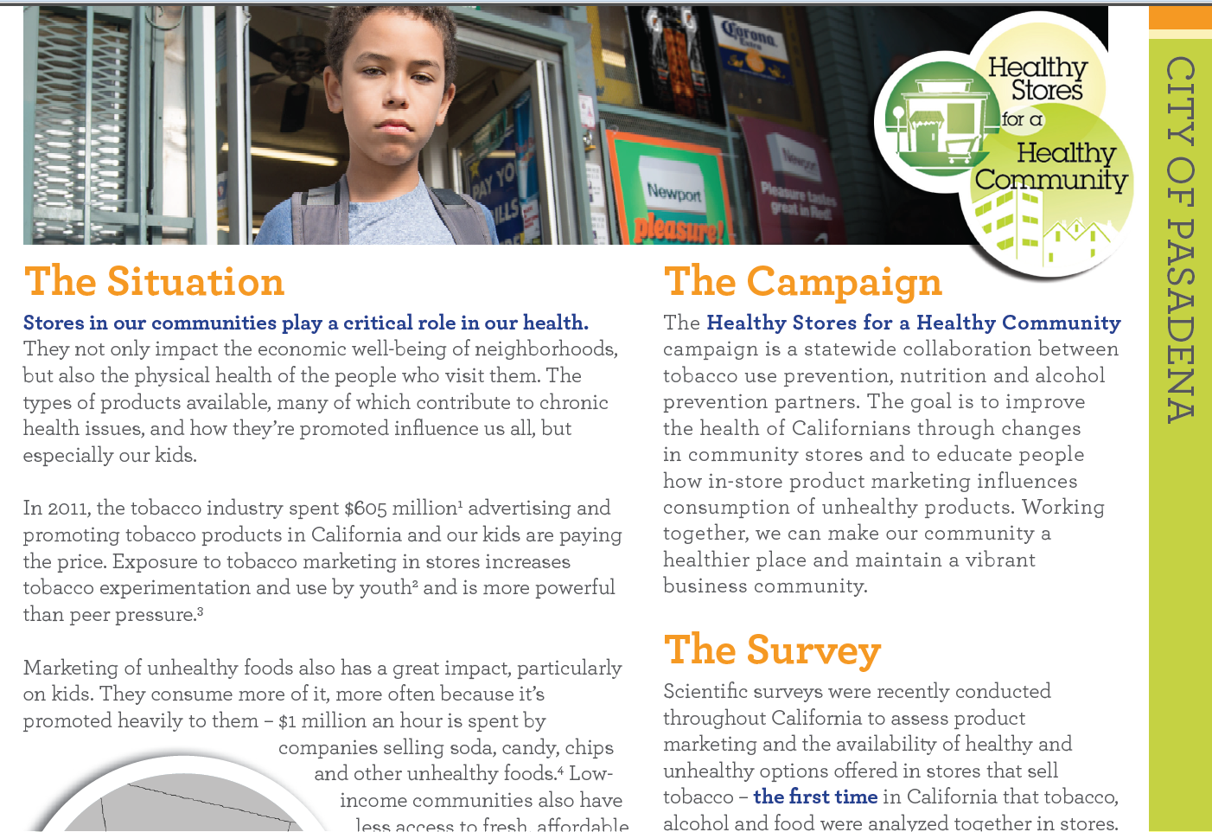

Slide 18
Notes:
templates for media releases,

Slide 19
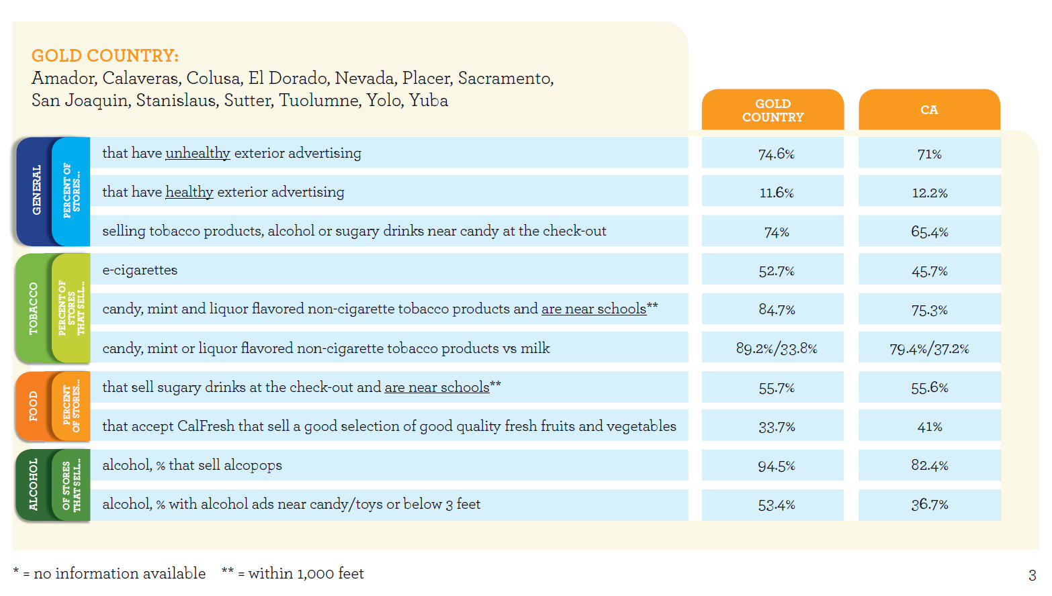
Notes:
as well as materials that organized the many pieces of data into digestible formats.

Slide 20
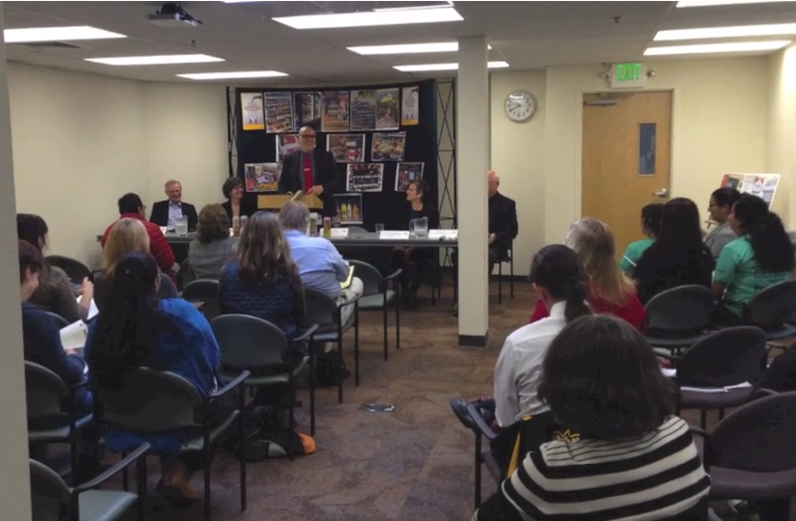
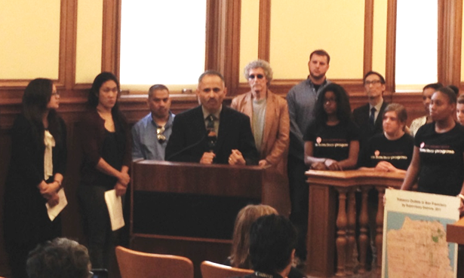
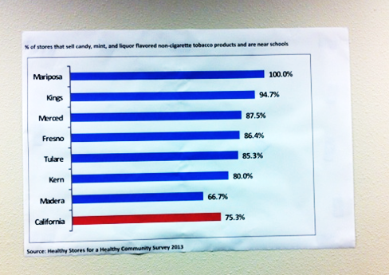
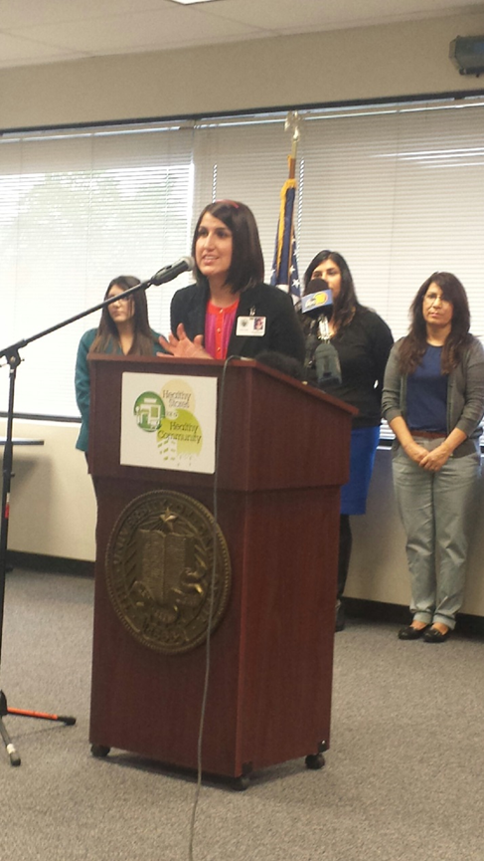
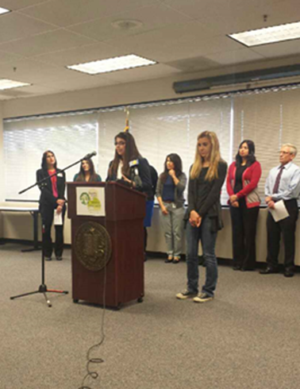
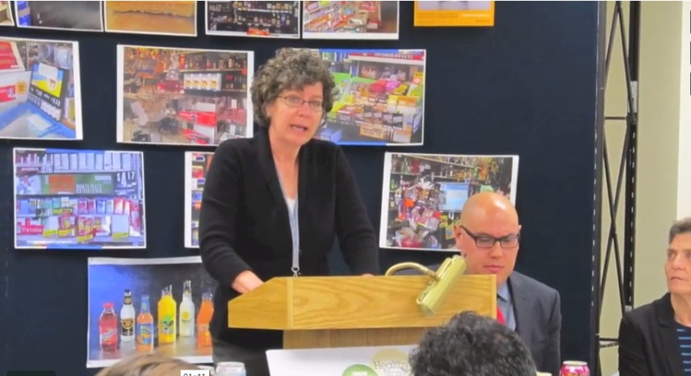
Notes:
These materials were adapted for each jurisdiction and given to the reporters at 12 regional media events held around the state on March 5th, 2014. To create a media frenzy, data were embargoed until this coordinated statewide release. To ensure that the coverage would be rich and informative, reporters were given data visualizations that depicted not only the physical context of the retail environment, they also summarized the key factors that are affecting the health of local communities.

Slide 21
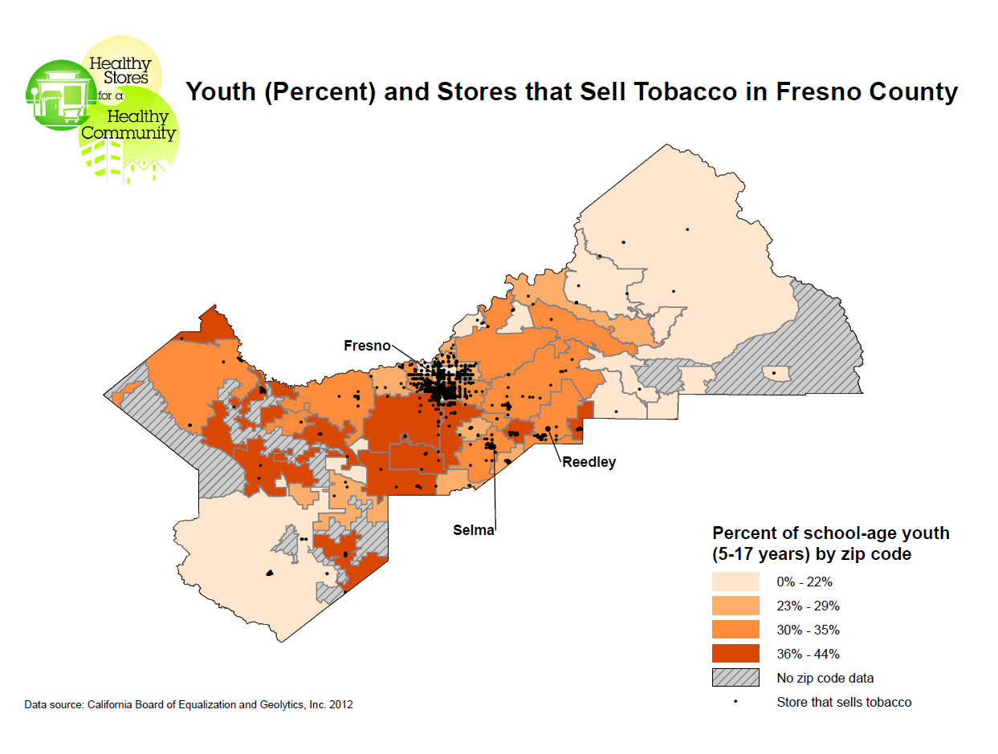
Notes:
Let’s take a closer look at some of the ways the campaign used data visualization. Here’s an example of a map that shows the relationship between store density and school aged youth.

Slide 22
Notes:
This data sheet describes store characteristics and summarizes key data points related to tobacco, food and alcohol products comparing local data to statewide rates.

Slide 23
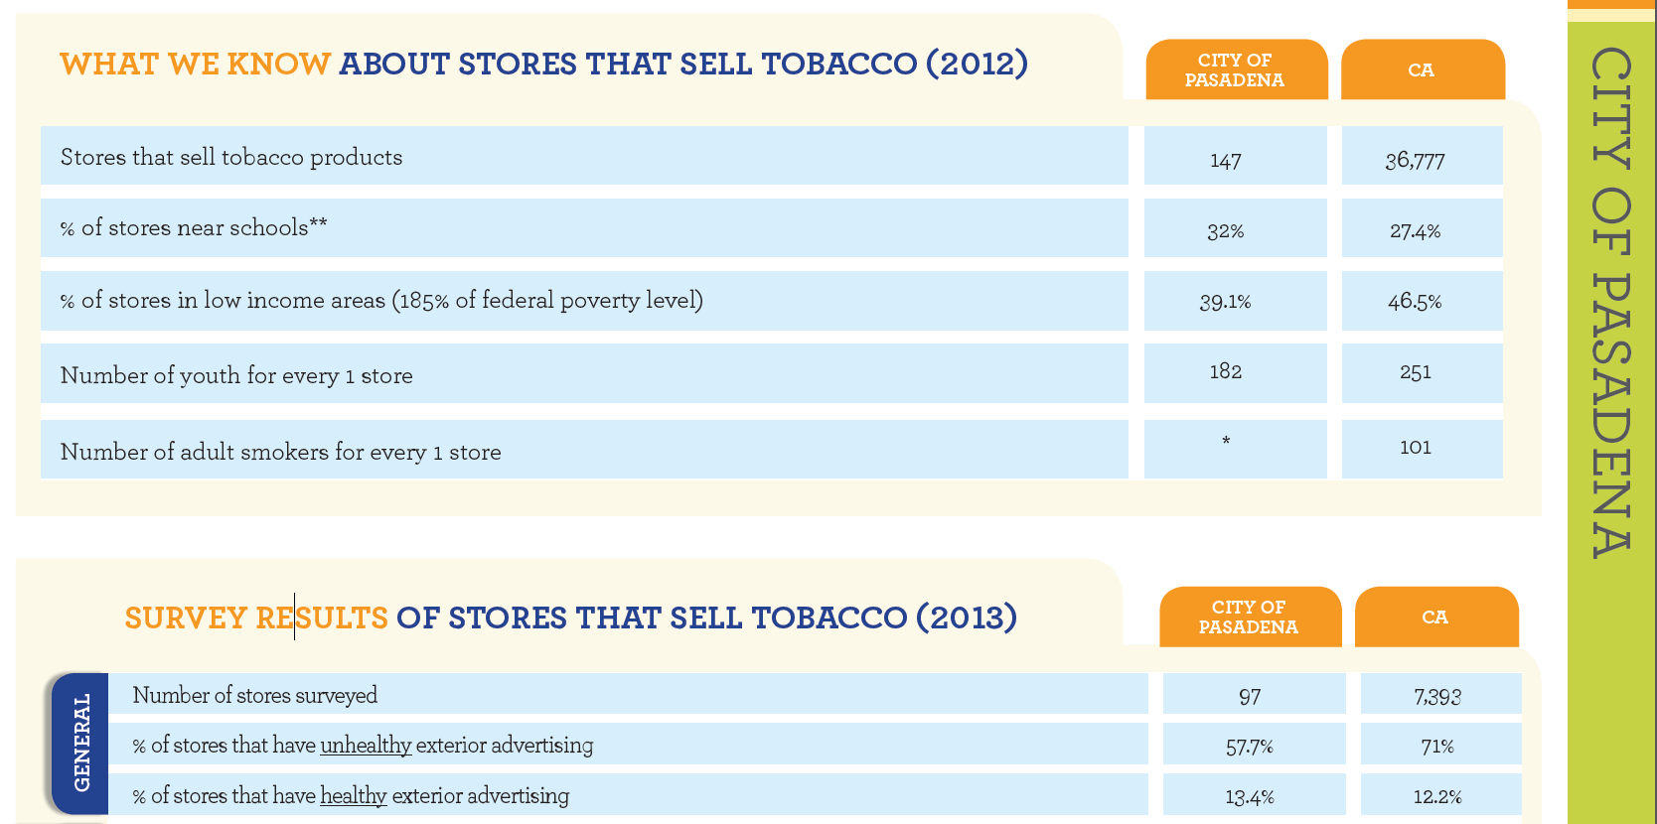
Notes:
Here’s a close up of the store characteristics for the jurisdiction of Pasadena, one of the 3 cities in the state with its own public health department.

Slide 24
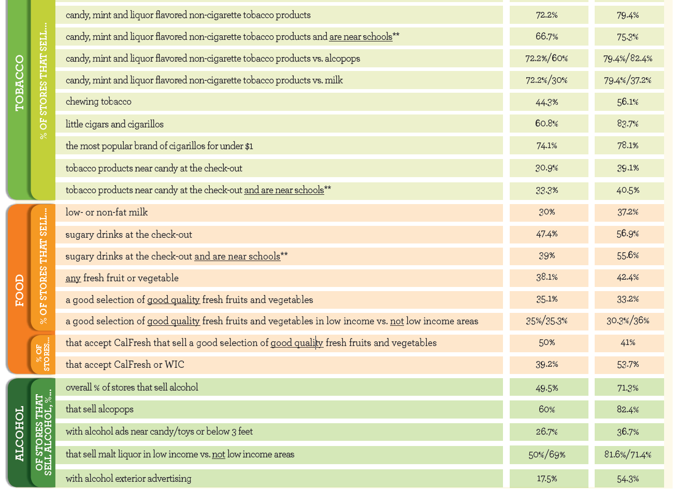
Notes:
In this jurisdiction, for example, 72.2% of retailers sell flavored tobacco products which are aimed at appealing to youth!
In addition to these standardized materials, local projects were encouraged to produce their own data visualizations to highlight key findings that were unique to their own retail environment which we’ll look at in a minute.

Slide 25
Mission accomplished?
Notes:
We wanted to know if all of these efforts made a difference. Were we successful in translating evaluation findings into eye-catching representations that tell a compelling story about the need for policy action?
Drawing on content analysis of media activity records and examples of effective visuals as well as key informant interviews with tobacco control project directors, we examined the role data visualization played in generating media coverage during this statewide campaign.
What we found:
The state produced very professional materials adapted by locals w relevant data; few counties supplemented with other data viz given to media; quality variable
Many/most created data viz with results to use internally for planning
Responses did often not make a distinction between data viz and data (perhaps we asked the wrong/unanswerable question)
Confusion over what is/is not a data viz (ex. Photos not = images w key findings)

Slide 26
Notes:
Glenn County
So here’s an example of a data viz generated by Glenn County which focuses on exterior advertising of healthy vs unhealthy products.

Slide 27
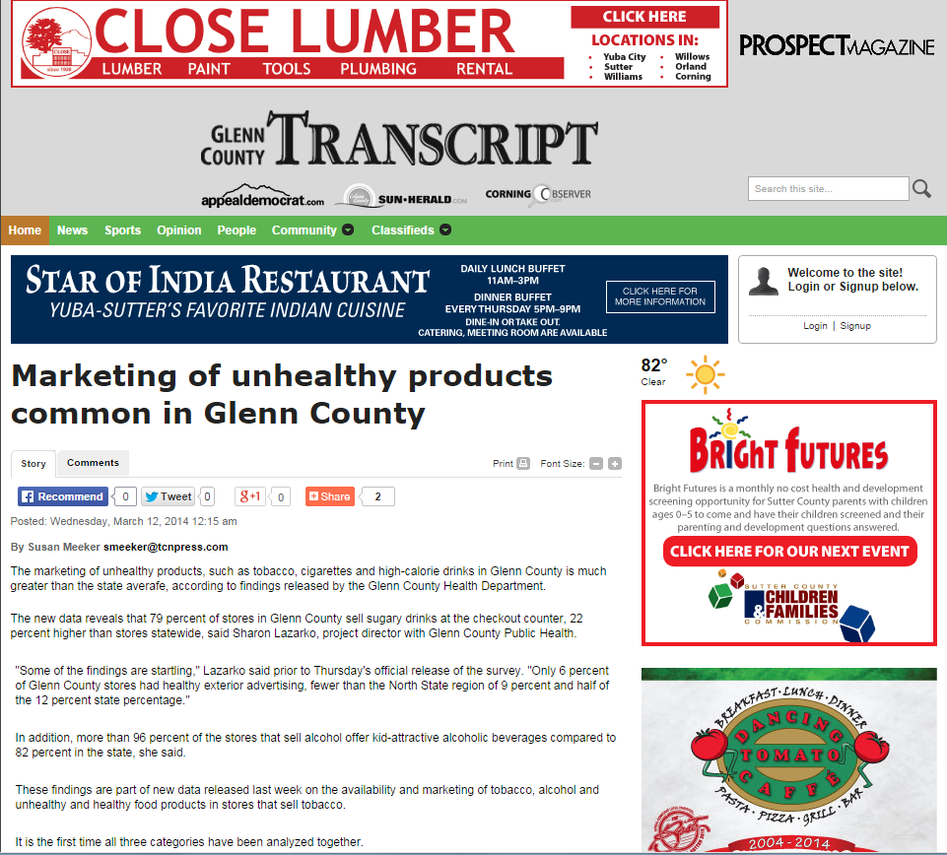
Notes:
And this is how the local newspaper portrayed the story.

Slide 28
Notes:
So you can see that the focus on unhealthy products was picked up as the headline of the news story. Not a bad correlation!

Slide 29
Notes:
Contra Costa County
Here’s map from Contra Costa County showing the density of retailers within 1000 feet of schools.

Slide 30
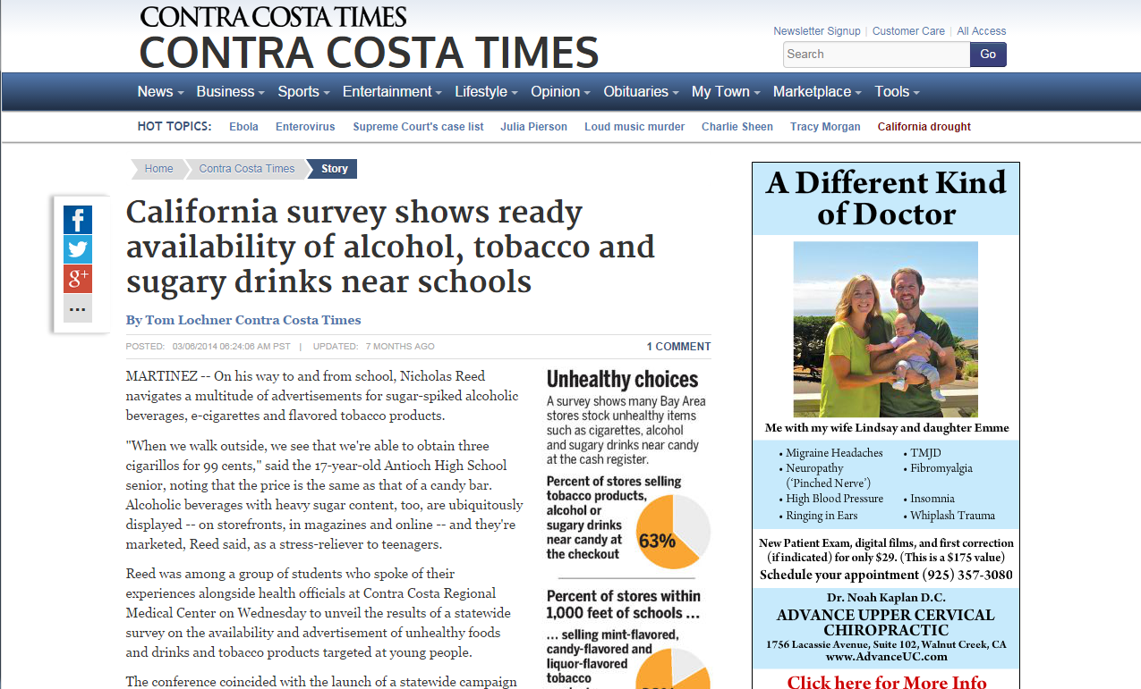
Notes:
And there is the headline from the local newspaper. Note also that the article includes several pie charts about several different data points.

Slide 32
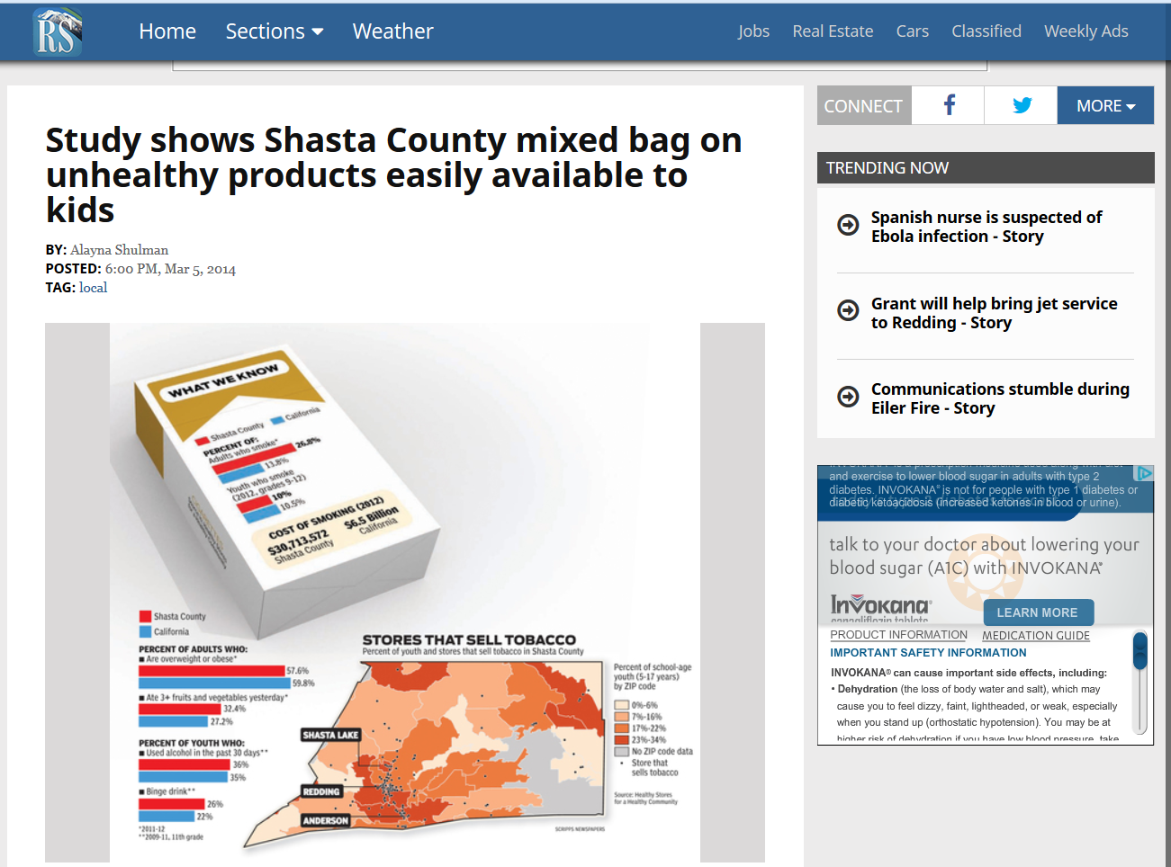
Findings
Notes:
We also saw instances where the MEDIA created their own data visualizations like the pack of cigarettes in this story. In all, the media created 262 pieces for newspaper, TV, radio and online outlets potentially reaching an estimated 120 million impressions (circulation x # hits, duration on site, etc.)

Slide 33
Oversupply of Tobacco Retailers July 2014
 | California | Butte | Oroville | Gridley | Chico | Paradise
Population, 2010¹ | 37,253,956 | 220,000 | 15,546 | 6,584 | 86,187 | 26,218
Persons above 18 years, percent, 2010¹ | 75.4% | 79.0% | 72.6% | 71.3% | 80.5% | 82.8%
Persons 18 years and over, 2010¹ | 28,089,483 | 173,800 | 11,286 | 4,694 | 69,381 | 21,709
Tobacco retailers^{2,3} | 36,000 | 245 | 47 | 13 | 101 | 28
Adults, youth and children per tobacco retailer | 1,035 | 898 | 331 | 506 | 853 | 936
Adults per tobacco retailer | 780 | 709 | 240 | 361 | 687 | 775
Adult smoking prevalence, 2011-2012⁴ | 13.6% | 18.2%
Approximate number of adult smokers | 3,820,170 | 31,632
Adults who smoke per tobacco retailer | 106 | 129
Youth population | 9,164,473 | 46,200 | 4,260 | 1,890 | 16,806 | 4,509
Youth per retailer | 255 | 189 | 91 | 145 | 166 | 161
¹ Census 2010, http://quickfacts.census.gov/qfd/states/06/0654386.html
² Stanford Prevention Research Center, July 2012
³ California Board of Equalization, July 2014
⁴ California Health Interview Survery, 2011-2012
Notes:
As stated before, each project created materials for local policymakers, coalitions, public to advocate for policies that limit the availability, affordability of tobacco and alcohol products and increase availability of healthy foods.
As you might expect, when projects produced their own data visualizations, the output reflected quite a range in expertise and complexity. With a better application of data visualization design principles, this table could convey its key point much better which is that there are way too many tobacco retailers in this county. For every 91 young people in this [redacted] city, there is an outlet selling tobacco compared to the rest of California where it’s only 1 retailer per 255 youth.

Slide 34
Notes:
This table is a little bit better. It summarizes many of the data points from the store observation but has clustered and color coded results by topic areas : tobacco findings in green, healthy foods in orange and alcohol products in red.

Slide 35
Notes:
Here’s one an example of a bar chart depicting youth and adult tobacco use rates.

Slide 36
Source: Bright Research + Dorrington Consulting
Notes:
San Mateo data dashboard
On the far end of the spectrum is a data dashboard created by San Mateo County and their external evaluation firm Bright Research and GIS expert and Dorrington Consulting. This interactive data visualization allows users to see where healthy vs unhealthy retailers are located…

Slide 37
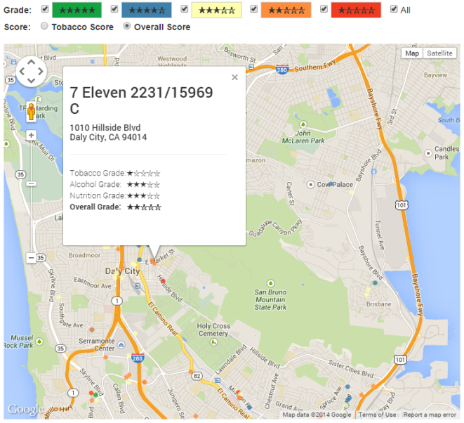
Notes:
And drill down to individual store level to see how they rated according to a scoring matrix the county developed.

Slide 38
Notes:
Comparing location of “good” vs “bad” stores
This dashboard will be made public so that policymakers, retailers and community members can use these tools to tell the story of health in their community.
With the wide range of data visualizations produced by local projects, the state and the media, we wanted to know what difference it all made – what reactions, inquiries or responses were generated by them?

Slide 39
Strong Emotional Responses
Notes:
Through our KIIs, we asked projects what kinds of responses were elicited from the data visualizations, media coverage, and various presentations and outreach. They reported that there were strong emotional responses both positive and negative. Here are a few highlights:
Butte County health officer and clinicians at a health staff training were stunned by the findings and the density of retailers in Oroville. (Raul Raygoza)
Orange County received strong positive feedback from coalition members. They had a better understanding their project goals a better sense of context. (Anabel Garcia)
But in rural Sutter County, some conservative policy makers reacted negatively and claimed the project was lying, that it was a misuse of the data and hurting business.

Slide 40
Turning Statewide Data Collection into a Media Frenzy: the Role of Data Visualization
Follow up and recruitment
Notes:
Other counties reported that the presentations enticed more volunteers to join the ranks.
LA County: “Lots of people have contacted wanting more information… wanting further analysis of the data. Generated a lot of interest and new non- traditional partners.” Heather Frank
Pasadena: “Helped generate volunteers who are very interested in seeing the outcome of the campaign.” Statice Wilmore

Slide 41
Describing the power of data visualizations
Notes:
Other counties immediately saw the value of investing the time to create data visualizations.
Kern County: “It helps a lot. If you see a picture you can’t escape it.” Nsale Nsuangani
Mariposa County: “Data visualization makes it pop out, makes it so digestible they can get the point very quickly.” Sue Haun evaluator.
Merced County: “This really helped people to grasp the main message and see the findings of the data…” Evi Hernandez

Slide 42
Strategy – Messaging – Framing
Notes:
Other counties learned a lot from the process.
Nevada County: “Have to be strategic and focused… must be careful not to come off as anti-business.” Shannon Glaz
San Mateo County: “Learned that they have to be careful in how they pose the data. They want the data to be an empowering tool for the community, not something that calls out individual retailers and makes them feel demonized.” Shaunda Scruggs

Slide 43
More Please!
Notes:
From our KII we also heard their requests for more TA, webinars, and resources on how to create their own data vis and more of them to use for other policy objectives, planning, and sharing results w partners and online.

Slide 44
Training Framing Examples
Notes:
They want to make sure that the Data viz communicates Advocacy & empowerment with a balanced message and proper framing so that they don’t vilify stakeholders they need cooperation from. They want help honing the message and call to action to garner support and momentum for policies that change the landscape of the local retail environment and make a healthy impact on people’s lives.
One of the lessons we’ve learned from this research is, that there’s a wide range of understanding and expertise among our client so we still need to work on conveying the basic principles of data visualization.

Slide 45
Templates Plug-ins
Notes:
Secondly, when working with orgs that have ltd resources and skill it’s effective to create templates where projects can just plug in their own data/info/message. They’re in need of step by step instructions and tools, and are looking for a gallery of data vis examples. We heard them loud and clear and will be working on providing those resources – drawing on the expertise of people in this room and in the field. So don’t be surprised if we contact you in near future!

Slide 46
Robin Kipke, Catherine Dizon, Miriam Hartig, Jorge Andrews, Jeanette Treiber, and Diana Cassady
We’d also like to thank the media unit at California Tobacco Control Program and all of the local health departments involved in this project.
Website: http://programeval.ucdavis.edu
Email: tobaccoeval@ucdavis.edu
Main line: 530.752.9951

