Slide 1
Policy
Record review
January 19, 2022
Notes:
RECORD!!!
Good morning everyone and thank you for joining us on this webinar about a very common evaluation activity that is in EVERY CTCP-funded workplan: the policy record review!

Slide 2
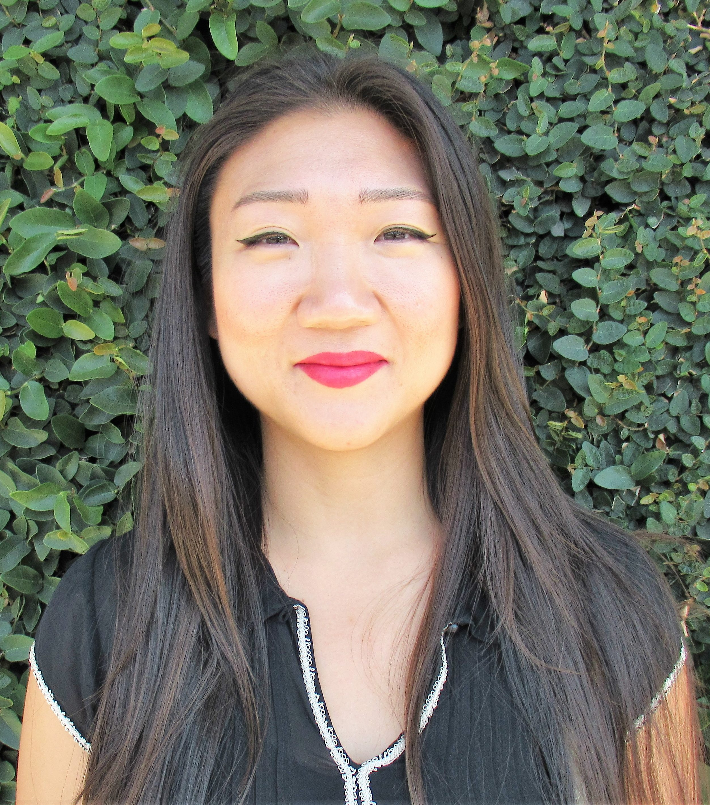
Toki
Catherine
Notes:
My name is Catherine Dizon (she/her) and presenting with me today is Toki Ko, the Organizing and Engagement Manager with the American Heart Association’s new California Tobacco Endgame Center for Organizing & Engagement. She has led teams working on a variety of tobacco prevention issues in Los Angeles County and helped to successfully ban the sale of flavored tobacco products in Oakland, CA. She is an ardent advocate for health equity and removing racism from all platforms of government. Thanks for being here Toki!

Slide 3
Agenda
Agenda
Notes:
This slide is simultaneously our agenda
CLICK
AND lists the 3 components to a PRR. Look at us being efficient!

Slide 4
Deliverables:
Decision-Maker Background Summary
Document Review Summary
Signed Policy
When and Who?
Notes:
Each of these also correspond to the deliverables that are due. For LLAs, this will already be listed in OTIS. For CGs, this is what it will be in in the future and what you can start submitting now if you’d like to use these new resources we’ll be sharing.
CLICK
We’ll start talking about the document review summary.
CLICK
Toki will take over with the decision-maker background summary.
CLICK
The last part of a PRR for each jurisdiction is the signed policy.
CLICK
We’ll also cover WHEN to do the PRR and WHO is best suited to do it.

Slide 5
When is the PRR due?
Notes:
Actually, let’s just go ahead and cover WHEN right now. And let’s make it a poll question
When is the PRR due?
First 6 months of the start of funding
When starting in a new community
On an ongoing basis
After a policy is adopted/signed

Slide 6
When is the PRR due?
in first 6 months
Notes:
The first due date of a PRR is within the first 6 months of starting your workplans. If you’re wrapping up in one community and are going to move onto another community, then it needs to be done within the first 6 months of starting in that new community.

Slide 7
When is the PRR due?
s
Ongoing basis
Agenda item
Election
Retirement
New info
Signing
Notes:
You might also submit updated deliverables on an ongoing basis like if
-the issue is brought up during a city council meeting or
-if there’s an election or retirement of elected officials or other decision-makers
-if another new document is found
And the due date of a signed policy depends on when the policy gets signed, so there’s no specific due date, but it should be submitted after the policy gets signed.

Slide 8
Deliverables:
Decision-Maker Background Summary
Document Review Summary
Signed Policy
Notes:
Are we all clear about WHEN policy record reviews are due?!
The first deliverable we’re covering with is the document review summary.

Slide 9
Public documents
Lease
language
Principles of
Community
Sponsorship
statement
Campaign
mailers
Notes:
Document review summary includes data that comes from public documents or reports. Now, they might not be on paper anymore, you can find most of the information electronically, online, or sometimes it’s sent to you in a newsletter or things like campaign mailers.
And it doesn’t have just be limited to legislated policies. Even though it’s called a policy record review, you’re not just looking at policy language or counting the number of policies. It could also include
CLICK
Lease language like for smoke free housing
CLICK
Statements or proclamations that an they will not accept tobacco industry funding
CLICK
Principles of community or cultural competency statements or goals
CLICK
Campaign mailers or newsletters from elected officials or people running for office or any other type of entity e.g. behavioral health, restaurants or businesses, places of worship, shopping malls, it depends on your public health issue
So these documents can cover a variety of topics. Now, where do these topics come up?

Slide 10
meeting agendas/minutes
voting records, biographies
sample/model polices
background research on current policies
Notes:
CLICK The most common source is from meeting agendas and minutes and sometimes recorded videos. In an ideal world, we’d attend the city council meetings ourselves and take notes ourselves rather than relying on someone else’s interpretation, but that’s not always feasible or efficient, so a review of the minutes is common. Either from attending or reviewing minutes, you can learn a lot about how this decision-making body functions and stay up to date with issues in a jurisdiction. And it doesn’t have to just be municipal decision makers, you might look into tenant or homeowners’ associationcouncil meetings, downtown business association, chambers of commerce, outdoor spaces committees, or a variety of other groups that convene..
CLICK Now sometimes voting records are separate and sometimes they’re embedded in the minutes. You want to get an idea of how supportive or unsupportive they might be to public health topics. You can see who else was involved at the time, and even if it’s from a while ago, maybe contact them to share more insights with you. It may also help find compelling angles for connecting with current policy makers e.g. if they support environmental topics, try to frame tobacco issues as an environmental issue. Or if the opposite is true, then actively do not use that lens. You might be able to learn about issues they’re interested in by searching the policy maker’s biography online like a campaign page. Toki will cover more of this later.
CLICK Sample and model policies are available from the law and policy center or on Partners. You might want to have this ready to be able provide TA on how to craft the language or to give an idea of what’s possible. You can also search what has been successfully passed in nearby. Sometimes it helps to point to a neighbor and say, well they got to do this, so can we!
CLICK also remember to search for existing policies to see if there’s already something in place and if so, does it need to be strengthened or could see what other tobacco control or public health policies are of interest and build on that momentum.

Slide 11
In the chat:
What are some helpful places to find this info?
Notes:
The bulk of this activity is done in the beginning, so you get the lay of the policy land so to speak. Sometimes you want to focus on the history of a type of policy and can see how your policy topics have been considered in the past. You’ll want to do some homework about the governing body specifically, to see how they’ve talked about or voted on public health topics previously. One of the best ways to get an idea of how to proceed and go forward is to look back to see how the issue has been addressed in the past. “Know your roots” so to speak, or at least the roots of this issue.
So, I’ll stop here to see if people have questions or anything to add about document reviews.
CLICK
Ok, in the chat…please share any websites that you’ve found to be helpful sources of this type of information? It can be a link if that’s easy to get or just type where you’ve looked in the past.
https://guides.library.unlv.edu/civicengagement/researching
https://library.municode.com
https://blogs.loc.gov/law/2013/11/municipal-codes-a-beginners-guide
https://igs.berkeley.edu/library/california-local-government-documents/codes-and-charters
https://libguides.law.chapman.edu/calmunicipalcodes
From chatbox:
Social Media of elected officials
City/County websites
Campaign websites for elected officials
PETS website
Rover
City/county municipal codes and city council minutes
City County and County meeting agendas and minutes
City standing committees, strategic plan Committee meeting minutes that elected officials are part of.
Previous Final Evaluation Reports
Local media where they are quoted on policy positions can help too! Chambers of
Commerce websites

Slide 12
Deliverables:
Decision-Maker Background Summary
Document Review Summary
Signed Policy
Notes:
Now I’ll hand it over to Toki to cover the Decision-Maker Background Summary

Slide 13
Decision Maker Matrix
Kathy “Toki” Ko, Organizing and Engagement Manager
Notes:
Pronouns! Happy New Year

Slide 14
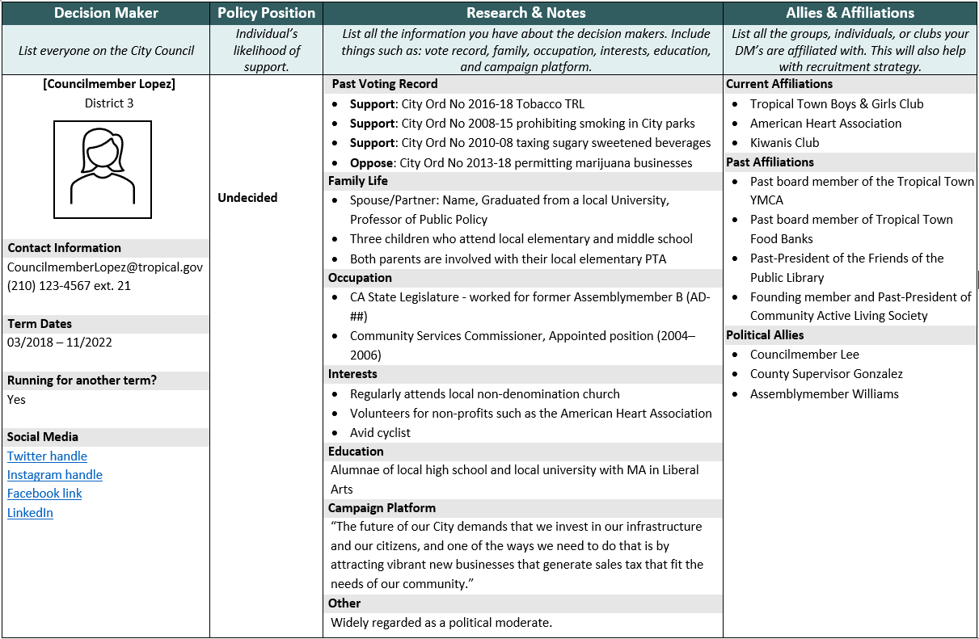
Decision Maker Matrix:
Councilmember Lopez
Notes:
This tool and process helps to map the personal and professional background and relevant interactions of the decision maker.
Here on our screens is an completed Decision Maker Matrix, but you can download an empty matrix on our website to fill out with your coalitions. This tool will help determine how a coalition can use its network and relationships to connect and influence a decision maker, and to complete the Decision Maker column of your MASC.
*Animation*
As you can see, the matrix it is broken up into 4 columns…
Now to make the DMM easier to understand and more digestible, we are going to go through it column by column.
However, before we dive into these columns, I want to preface all of this with that this is a very condensed version of a DMM for training purposes.
Campaign Planning is hard work, and most coalitions will not complete this nearly as quickly as we will be demonstrating today.

Slide 15
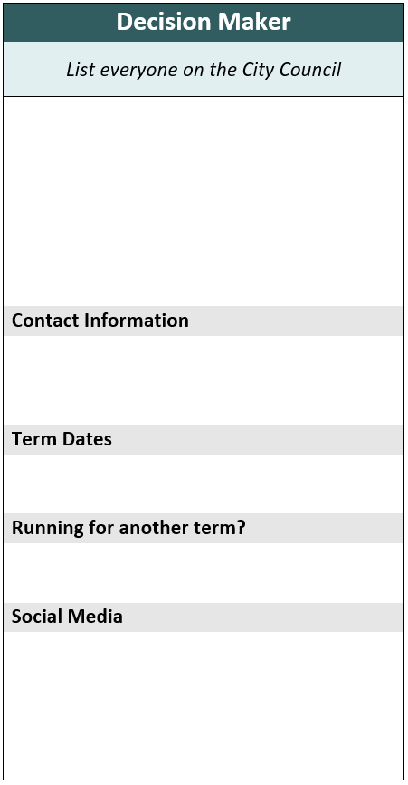
Decision Maker
1
Councilmember Lopez
District 3
Councilmember, Supervisor, or Tribal Leader
2
CouncilmemberLopez@tropical.gov
(210) 123-4567 ext. 21
3
03/2018 – 11/2022
4
Yes
5
Twitter handle
Instagram handle
Facebook link
LinkedIn
Notes:
Here before us is the first column of the matrix, The Decision Maker column.
As previously mentioned in our last webinar, the decision maker is the city councilmember, county supervisor, or tribal elder who has the power to pass or reject your policy.
You include EVERY decision maker regardless of their policy position. Additionally, every decision maker requires their own separate matrix.
There are five simple areas in this column you should complete prior to sharing this matrix with your coalition.
*Animation* 1st: The first step in completing this column is to identify the decision maker and which district they represent.
In this example shown here, we have Councilmember Lopez.
So how do we find the district that the decision maker represents? The quickest way to find out the district is by going to the official city or county website.
Now, not all councilmembers in the state represent a specific district and some may be elected as an at-large councilmember. So, you may not have a specific district to list here.
*Animation* 2nd Step: In this second step, you will list the decision makers basic contact information, including their official email address and their office’s number.
*Animation* 3rd Step: In the third step, you will list the length of the decision maker’s term and if they are running for another team.
This information is usually found on the city’s website.
*Animation* 4th Step: In this 4th step, you will note if the decision maker is running for another term.
Through a quick search on his campaign website, the coalition learned that Councilmember Lopez has publicly declared that she will run for re-election.
Noting this is important as it can be useful to understanding our coalition’s electoral power over Councilmember Lopez. If she’s not running for another term, it is difficult for our coalition to wield electoral power over him.
*Animation* 5TH step: In this 5th and final step, your coalition will put down the decision maker’s social media contacts. You can choose to write down their social media handles or hyperlink them.

Slide 16
Policy Position
How do you determine the decision maker’s policy position on your tobacco issue?
Notes:
A key component of the DMM is knowing the policy position of each decision maker. This column is fundamental to determine if it is prudent to invest the coalition’s time and resources to build a relationship with a decision maker to culminate a higher probability of getting a policy to pass. If it is highly unlikely that a decision maker will oppose your policy, then it would be inefficient to continue to pursue them but they should still receive factsheets or other info during city council meetings or educational presentations.
First, lets look at their voting record to determine a policy position.

Slide 17
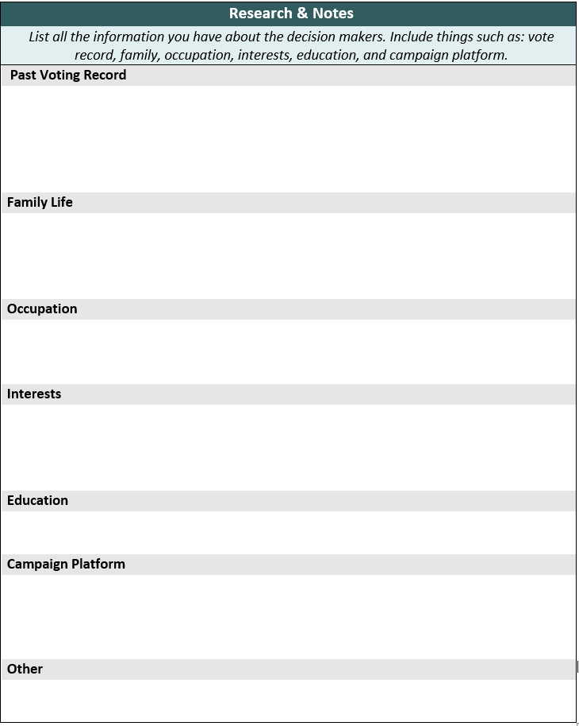
Research & Notes Past Voting Record
1
Support: City Ord No 2016-18 Tobacco TRL
Support: City Ord No 2008-15 Prohibiting smoking in City parks
Support: City Ord No 2010-08 Taxing sugary drinks
Oppose: City Ord No 2013-18 Permitting cannabis businesses
Past Voting Record
Biographical Information & Other
Utilize your Policy Record Review
Note tobacco policy issues & other relevant health related policies
Notes:
In this column of the matrix you will list all the information you have on the decision maker. This includes their relevant past voting record, their family, occupation, interests, education, and campaign platform. That is a lot to handle so let’s keep it simple and start with Councilmember Lopez’s past voting record.
*Animation*
This section is where your coalition will examine the decision maker’s past voting record to help you determine where they might stand on your related issue(s). The obvious voting records you will post on this pertain to tobacco related issues but you may need to go further than that and include other relevant related policies such as a soda tax ordinance.
In this example, we see a voting patter, she supported all tobacco ordinances but we also discovered that she opposed a cannabis ordinance.

Slide 18
Research & Notes Biographical Information
1
Support: City Ord No 2016-18 Tobacco TRL
Support: City Ord No 2008-15 prohibiting smoking in City parks
Support: City Ord No 2010-08 taxing sugary sweetened beverages
Oppose: City Ord No 013-18 permitting marijuana businesses
2
Spouse/Partner: Name, Graduated of local University, Professor of Public Policy
Three children who attend local elementary and middle school
Both parents are involved with their local elementary PTA
Family
Occupation
Interests
Education
Campaign Platform
Other
3
CA State Legislature - worked for former Assemblymember B (AD-##)
Community Services Commissioner, Appointed position (2004–2006)
4
Regularly attends local non-denomination church
Volunteers for non-profits such as the American Heart Association
Avid cyclist
5
Alumnae of local high school and local university with MA in Liberal Arts
6
“The future of our City demands that we invest in our infrastructure and our citizens, and one of the ways we need to do that is by attracting vibrant new businesses that generate sales tax that fit the needs of our community.”
7
Widely regarded as a political moderate.
Notes:
You will put down the basic biographical information here, but you want to be specific and relevant. Look for interests or relationships of Councilmember Lopez that may highlight her interests on tobacco issues or other public health related community/public health issues.
Let’s start with family life.
*Animation*
Include info about their partner and if have a correlated occupation such as a professor of public health at the local university.
If they have school aged children, include that as well. If your coalition discovers they are involved in a local PTA, that is an important detail you will want to include.
*Animation to 7*
Why? Because your coalition can analyze how they can leverage these connections with their own network. By identifying that they are involved in their local PTA you just gained insight into their priorities but also have identified a potential pathway to influence the decision maker. Perhaps they may be more inclined to your policy if you frame your issue with a youth lens.

Slide 19
Political Allies & Affiliations
1
Tropical Town Boys & Girls Club
Kiwanis Club
2
Past Board Member, Tropical Town YMCA
Past Board Member, Tropical Town Food Banks
Past-President of the Friends of the Public Library
Founding member and Past-President of Community Active Living Society
Affiliations: Community-based organizations, groups, or clubs that the decision maker has been associated with or is a current member.
3
Councilmember Lee
County Supervisor Gonzalez
Assemblymember Williams
Political Allies: Organizations, notable individuals, or elected officials that have a common interest with the decision maker and have provided their political support.
Notes:
Go over Definitions, provide examples from right.
*Animation to 3*
From Chat:
Sample Dossier https://www.tcspartners.org/Files.cfm?FilesID=10229

Slide 20
Midwest Academy Strategy Chart
Notes:
While the DMM may seem like a lot of work to do with your coalition, think of it like a cheat sheet when it comes time to do the MASC. Once complete, the DMM will be very helpful in determining if the decision makers are undecided, a supporter, or an opponent. The undecided DM will become the focus of the work and resources used by the campaign.
After you have determined their policy position, based on your policy record review and your DMM/COI you can put down key details such as their past voting record, affiliations, interest, and political allies.
Then, you use that research to inform your approach to the DM. How much and what kind of power is needed to influence the DM and gain their support?

Slide 21
Deliverables:
Decision-Maker Background Summary
Document Review Summary
Signed Policy
Notes:
Thanks Toki! Ok, we’re almost there folks! This is the last deliverable for a PRR. And it’s also the “easiest” part of the PRR.

Slide 22
Submit in Otis
Notes:
Not the easiest part to get to, because it’s definitely a journey, but in terms of what to submit, you’ll probably just upload the signed .pdf into OTIS. This could be in the meeting minutes, it could be in a press release, it could be on the website.
Ideally, it has information like the date of enactment and the date of enforcement, because those are often different dates.

Slide 23
Deliverables:
Decision-Maker Background Summary
Document Review Summary
Signed Policy
When and Who?
Notes:
Ok, so we’ve covered almost everything we said we would. The only thing left is WHO. Who is the BEST suited person to conduct the PRR?
POLL
Who is the BEST suited person to conduct the PRR?
Evaluator
Project Director
Other Project Staff
Coalition
Communications

Slide 24
Project staff
Notes:
A PRR is BEST conducted by…CLICK
project staff
I know project staff wear many hats and must monitor a lot of different things, and this is another monitoring activity that really should be taken up by a project staff person. And like we established earlier, the PRR may need to be done on an ongoing basis, meeting minutes need to be monitored or even attended and project staff are most likely to have the bandwidth to do this. We recommend that you have someone that is closer to the project and the community to conduct this activity and update it as well.
This doesn’t mean other cannot be involved. Certainly, your coalition might be interested in the findings or could be helpful sources for a lot of this info, and this is not to say your evaluator cannot do it, but it should at least be done in collaboration with a project staff person, not just something handed off for only your evaluator to do from start to finish.
Good task to be under “oversight” of evaluation that is required for each project.

Slide 25
TCEC Website:
NEW Policy record review tool and guidelines
CA Tobacco Endgame Center
for Organizing & Engagement:
Decision-Maker Matrix + more!
Partners:
Sample policy tracker
Notes:
Ok, we were able to get some ideas about where to find this information. Google is also your friend for gathering a lot of these documents. But there’s also tools to help…
The TCEC website has a revised PRR tool and guidelines. If you like the old one, it’s still there, but we have more tools on there now
https://tobaccoeval.ucdavis.edu/collect-data#PRR
New: https://tobaccoeval.ucdavis.edu/sites/g/files/dgvnsk5301/files/inline-files/Policy%20Record%20Review%201.18.2022_0_0.docx
Old: https://tobaccoeval.ucdavis.edu/sites/g/files/dgvnsk5301/files/inline-files/PolicyRecordReviewFormswprotocol%20%281%29.docx
Toki’s team has a ton of resources including more details on the DMM in both English and Spanish and a suite of other tools and trainings.
https://organizingtoendtobacco.org/category/resource/community-engagement-and-organizing/page/2/
Another tool I’ve seen people use is a sample tracker on Partners
https://www.tcspartners.org/Campaigns/LocalPrograms/ProgressReports.cfm
Resources > Local Programs > Progress Reports

Slide 26
Ideas?
Tips?
Questions?
Notes:
Reach out to Toki’s team at https://organizingtoendtobacco.org/community-engagement-support-gateway/
Or if you want help from the eval team contact tcecTA@phmail.ucdavis.edu

