Slide 1
Tell Your Story 3.0:
New Final Evaluation Report Guidelines
May 10-11, 2017
10:00-11:30 a.m.
Notes:
Today’s webinar is being recorded and will be posted on our website so that you and your colleagues can access it whenever you like. It will be available at tobaccoeval.ucdavis.edu under new releases and webinars
Participants have been placed on mute, so please use the chat box if you need assistance, can’t hear us, or have questions. If you want to be heard, press *7 to unmute yourself and *6 to go back on mute.
Last but not least, when we are done with the training, you will get a follow-up survey to get your feedback about this webinar. You will get one from the webinar program, but don’t take that one, respond to the one that comes from TCEC. If you were on our webinar on Tuesday, you should have already received that one. You’ll get a separate survey for part 2. Please take a few minutes to let us know what we did well today and how we can improve.

Slide 2
While you’re waiting, type in the chatbox:
If you’ve written part of a FER before: what challenges did you have, if any?
If you are new to this, what do you anticipate may be difficult? (e.g., combining different voices—from the project vs. evaluator, deciding which results to include, etc.)
What questions do you hope this training will answer?
Notes:
In the chatbox…
For those of you who have written any part of a FER, here is your question: WHAT CHALLENGES DID YOU HAVE, IF ANY?
For those that are new to this: WHAT DO YOU ANTICIPATE MAY BE DIFFICULT
For everyone, WHAT QUESTIONS DO YOU HOPE THIS TRAINING WILL ANSWER?

Slide 3
Agenda
Day 1
Welcome!
Ch Ch ch Changes
Setting the Stage
Aim and Outcome
Background
Evaluation Methods and Design
Connecting Intervention & Evaluation
Notes:
During our time these next 2 days, you have 2 pdf files to guide you through the training and provide space for your notes. The first document is called “TYS Training packet 1” and the second is called “TYS training packet 2” You can set aside training packet 2 for now and just focus on training packet 1.
Here’s how we plan on spending our time together.
After a quick overview the pre-training from last week where we emphasized utility, and talked about WHY the changes were necessary, Sue is going to go into end-use strategizing so that we can learn about the uses and users of FERs.
We’ll take turns introducing, applying, and discussing the various sections of the report, and if our timing works out – we’d plan on a break so that the information can really sink in.

Slide 4
Agenda (cont.)
Day 2
Connecting Intervention & Evaluation
Implementation and Results, Strategies for Writing
Making it Useful
Conclusions and Recommendations, Avoiding Landmines, “Rap” Up
Notes:
After the break, introduces the really meaty part of this training, and, to us, one of the most important changes to TYS: linking intervention and evaluation together so that users understand the full picture and learn from your experiences, challenges, and successes.
Because, not only should the intervention and evaluation tie together in your report, but from this point forward, it should also help connect for you so that you can better understand and foresee how your evaluation work informs your intervention and ultimately moves your objective forward when you’re in the middle of your plans.
All of that heavy hitting material will lead us into a discussion and section on how to make all of this happen. We’ll discuss the materials you’ll need and resources that you can turn to for help.
Then comes lunch…and another break to let the information sink in.
And we all have to get back promptly at 12:15 for the conclusions and recommendations section and finally a recap and “rap” up.
TCEC staff will be here afterward for office hours on specific questions, so you’re welcome to stay a little bit if you still have a little more gas in the tank from this jam packed week of tobacco control learning, otherwise, we welcome your calls and emails for questions that I’m sure come up once you get a chance to dig in to your own FER writing.

Slide 5
Notes:
Last month we offered a training on why Tell Your Story needed to be revised to this third iteration. The goal of that training was to provide the background, context, and rationale for changing the requirements and scoring rubric for writing evaluation reports. The new guidelines address past gaps and difficulties with writing, reading, scoring, and using FERs.
Our pre-training endeavored to create buy-in by demonstrating how it is grounded in research and practice in the professional evaluation field as well an input from your fellow LLAs and CTCP. The latest thinking emphasizes utility and audience – to share the results or the punchline up front, so you don’t make your reader wait – it’s not a novel or a research paper. It’s an evaluation report that is meant to be used.
We also listened to you all and your fellow report writers to make the reports more user-friendly, less redundant and duplicative of work already done – we aimed for a more efficient method, that instead provides richer, more useful information for your organizations and others.
If you weren’t able to join us last week, there is a recording available on our website.
Our overarching goal for that training and for today is to increase your general knowledge of evaluation, particularly in the USE of evaluation and of course, to efficiently write useful evaluation reports.
There are 3 themes for how we will couch our content today, and will share a neat acronym she developed later, but our themes for these trainings are:

Slide 6
Utility
Notes:
Our overarching goal for last week’s pre-training primer, for today’s training, and for the revisions to TYS in general is to increase your general knowledge of evaluation, particularly in the USE of evaluation and, of course, to efficiently write useful evaluation reports.
FERs should demonstrate utility of evaluation in general, but also should be written so that report itself is useful and that you’re keep your audience in mind as you’re writing it.
By the way, in your training packets on 3, these are your fill in the blanks…the first one being UTILITY

Slide 7
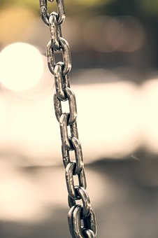
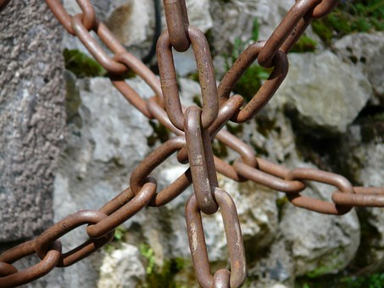
Connectivity
Notes:
The second blank is CONNECTIVITY
FERs should provide the connectivity from where your program started, where it ended up, and all the steps, missteps, successes, challenges, and everything in the middle that got you where you ended up. It should really be a historical record and roadmap for your organization as well as your colleagues that may want to work in the same area so that they can learn from your experiences.

Slide 8
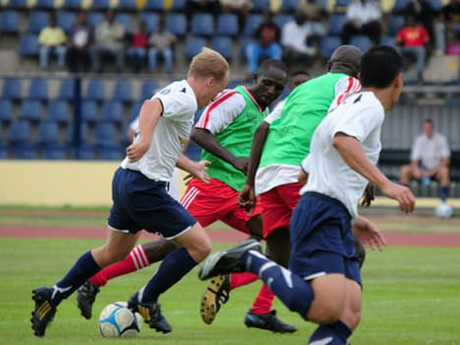
Cultural Competency
Tailor to Your Audience
Notes:
And our third theme is cultural competency. If this term is a little daunting or abstract to you, then you can think of it as tailoring to your audience. It’s not just referring to race/ethnicity cultures, but any cultures, like sports cultures – if I asked you talk with your table about football, you might talk about what these players are doing on the left…or you might talk about what they’re doing on the right. And those are two very different concepts with very different rules and fan bases!
And in the context of writing FERs, users of FERs want to know what you did in your communities in particular that were successful or challenging. We want to know about your cultural competency strategies or the ways in which you tailored your outreach, education, data collection, analysis, presentations, and everything else so that it will resonate and work in your specific communities.
CULTURAL COMPETENCY is the third blank

Slide 9
Almost There
istockphoto-warrengoldswain
Notes:
With those three themes in mind, let’s get into it!
You are almost to the end of the 2014-2017 scope of work. For that reason, it is time to start thinking about reporting what you accomplished and what you learned along the way.

Slide 10
Sharing
Results
WHO WHAT HOW
Notes:
Sharing results is more than just reporting to the California Tobacco Control Program. It’s also more than just checking off another box completed in your work plan.
Sharing results includes thinking about who is interested in the results of your project, what they will want to know and –pause- how, that is, in what format the information will be most useful to them.

Slide 11
Report Users
Notes:
There are a variety of evaluation report users. These users include:

Slide 12
Report Users
Funded TCP
Notes:
Funded Tobacco Control Project. Through evaluation, you (the LLA) document organizational history and also learn valuable lessons about the effectiveness of your programs and what works.

Slide 13
Report Users
CTCP, TCEC, Rover
Funded TCP
Notes:
CTCP, TCEC, Rover, etc. Educate the state decision makers about program impacts and demonstrate work completed, as well as identify best practices. This information is also archived in Rover.

Slide 14
Report Users
Coalition / Partners
CTCP, TCEC, Rover
Funded TCP
Notes:
Coalition / Partners. When LLAs communicate and share evaluation results with their partners or the public, they increase community awareness and acceptance of important tobacco control messages

Slide 15
Report Users
Coalition / Partners
CTCP, TCEC, Rover
Funded TCP
Local Policy Makers
Notes:
Local Policy makers. Educate policy makers about tobacco control issues and local policy impacts.

Slide 16
Report Users
Coalition / Partners
CTCP, TCEC, Rover
Funded TCP
Other TCPs
Local Policy Makers
Notes:
Other TCPs. Enable other organizations to replicate effective programs and strategies. Other LLAs might want to know keys to swaying policymakers.
And lastly,
The General Public. Increases awareness of problems and solutions, and motivates support for your efforts.

Slide 17
Report Utility: The Right Level of Detail for Each User
CTCP, TECC, ROVER
Full Report
Samples available at http://tobaccoeval.ucdavis.edu/analysis-reporting/ReportingResults.html
Notes:
Just as there are different users of final evaluation report information, there is a different level of detail these users care about. For example, the California Tobacco Control program asks that you talk about specific strategies that worked in your Final Evaluation Report. Here, in the full report, you would indicate whether or not gathering that public opinion poll data or gathering those 2,000 signatures was effective at swaying policy makers.

Slide 18
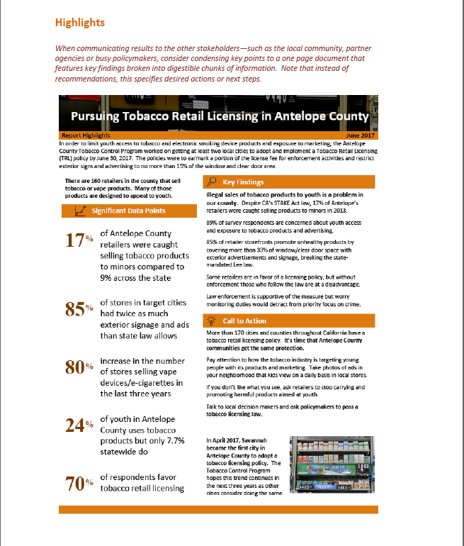
Report Utility: The Right Level of Detail for Each User
CTCP, TECC, ROVER
Policymakers, General Public
Full Report
Highlights
Samples available at http://tobaccoeval.ucdavis.edu/analysis-reporting/ReportingResults.html
Notes:
However, you may not want to inundate or bore some audiences with a long report that discusses effective strategies with the general public or even with policymakers. Instead you could provide a one page sheet with highlights. With policy makers, you could emphasize the scope of the problem. This is just the right length for policy makers because they are often very busy people and want to get to the bottom line quickly. This format could also be a good to use for the general public. You could emphasize scope of the problem, create a call to action or use it as an educational fact sheet with important county data to correct public misconceptions.

Slide 19
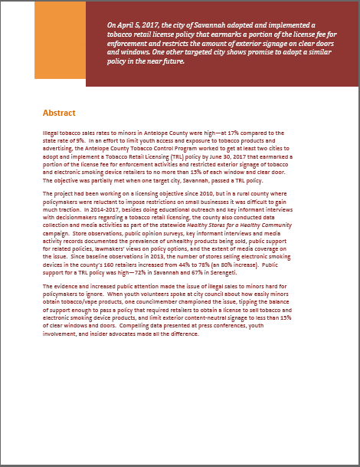
Report Utility: The Right Level of Detail for Each User
CTCP, TECC, ROVER
Policymakers, General Public
Other TCPs, Conferences
Full Report
Highlights
Abstract
Samples available at http://tobaccoeval.ucdavis.edu/analysis-reporting/ReportingResults.html
Notes:
Another format is the abstract. The abstract can be easily shared with other Tobacco Control Programs or projects, as well as be used for submitting to conferences or journals to share with colleagues and or a variety of funders.

Slide 20
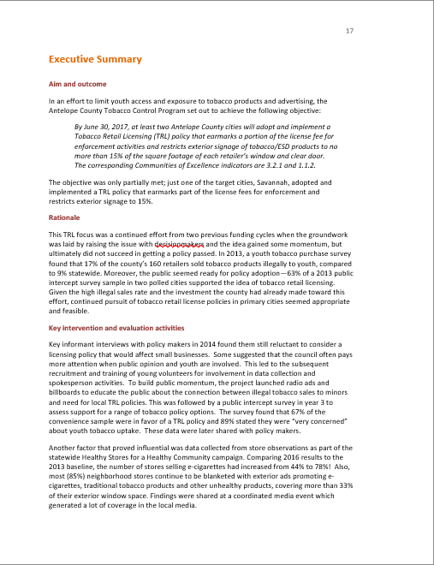
Report Utility: The Right Level of Detail for Each User
CTCP, TECC, ROVER
Policymakers, General Public
Other TCPs, Conferences
Coalitions / Partners
Full Report
Highlights
Abstract
Exec. Summary
Samples available at http://tobaccoeval.ucdavis.edu/analysis-reporting/ReportingResults.html
Notes:
An Executive Summary format, which is usually a 2 pager, might include different information than the highlights, which has little chunks of information with more visuals. Instead, the Executive Summary is more of a narrative and will document more activities. This type of Executive Summary is a format type that you would share with your coalition or community based partners because it is shorter than the report while still providing sufficient detail.
There is an example of the each of these products on the TCEC website, and we’ll have more resources and guidance on how to create these yourselves.
The point here that there are different levels of information that you can provide to different users to make the information more accessible as well as get the word out for your program.

Slide 21
FER Users & What They Care About
Exercise
2 sheets of paper with different report users
Strips of paper describing potential uses
Match each strip of paper to 1 of the potential uses
Affix strip on paper
Check the appropriate format(s) for the different users
Team that gets the most right gets a prize!
Notes:
During the in-person training, we had group activity here. And you’re welcome to do this if you have a group of you logging on together.
But for the sake of time, you can look at your packet for the answers and just imagine being with us in-person 2 weeks ago.

Slide 22
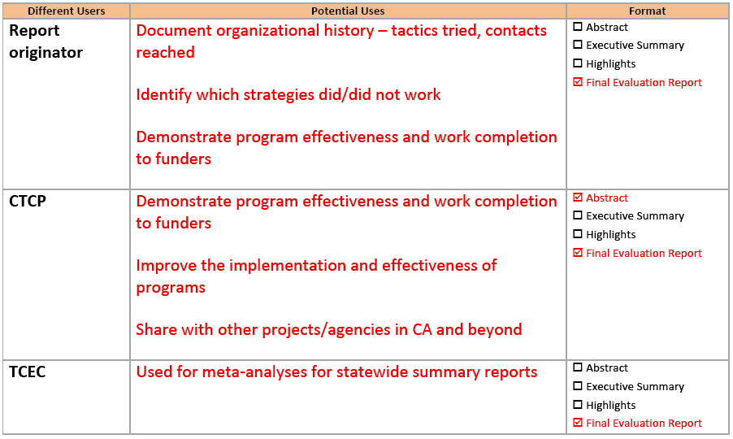
FER Users & What They Care About
Answer Sheet 1
Notes:
The answers are on page 4 and 5

Slide 23
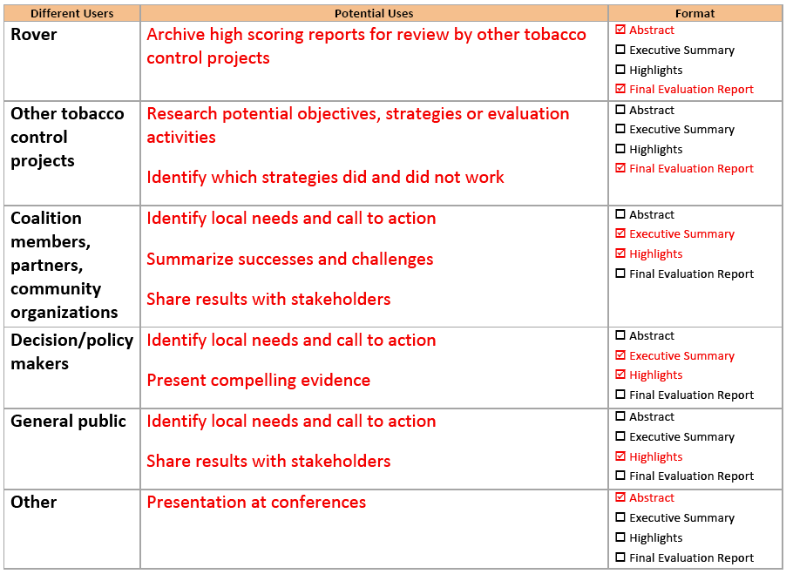
FER Users & What They Care About
Answer Sheet 2
Notes:
Take a look at those for a minute or two and we can chat about it afterward
Debrief – Were there any surprises? Did you come up with any other potential uses than what was listed?

Slide 24
The New “Tell Your Story” Guidelines
istockphoto-Israel McKee
n
Notes:
Ok, now that you have thought about who you need to communicate to, what they would want to know and in what format, it is time to introduce the new Tell Your Story Guidelines. Drum roll please . . .

Slide 25
Notes:
Ta da. The new Tell Your Story requirements are explained in various sections.
First, there is information about the background, which includes the rationale for the latest revisions to Tell Your Story

Slide 26
The New TYS
Notes:
Then updated instructions for writing the Evaluation Report. The instructions include a description of what each section of the report is to contain.

Slide 27
The New TYS
Notes:
a sample report. The sample report is provided so that you can see how the instructions and scoring rubric translate into a final evaluation report document. Again, these documents will be available online at the TCEC website so that you can access them at any time.

Slide 28
The New TYS
Notes:
And a Scoring Rubric that you can see what the reviewers will be looking for, when your report is read, and how the point structure is broken down.
Other supplemental documents, resources, and tips will be added soon. And after the first round of FERs coming in this June, we’ll probably be able to develop even more resources to help you for the next round of FER writing.

Slide 29
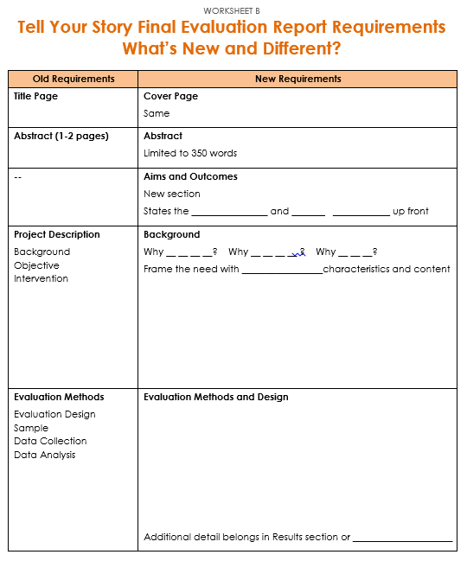
The New TYS
Overview
What’s New
Tools
Space For Notes
Notes:
In the training packet on page 6 is a copy of the worksheet that you see on the slide. Please get it out now.
As part of today’s training, we will focus on three things:
Providing an overview of the sections that need explanation. The Cover page is self-explanatory. The Abstract will be discussed in a separate training webinar. For that reason, today we will start with a focus on the Aims and Outcomes section.
Describe what is new. As we go through today’s training, we will emphasize what has changed so that the difference between the old Tell Your Story and the New version is clear.
As well as remind you what tools are available to you.
This worksheet is intended for you so that you can take notes as we go through the day and summarize the new requirements for Tell Your Story in the right hand column.

Slide 30
Aim
& Outcome
Notes:
The first section of the body of the report is the Aim & Outcome section.
This is one of the main changes to the guidelines and the reason for the change is because it is important to state the objective and if you achieved the objective right at the front, right at the beginning.
As a reader, I don’t want to wait to have to read to see if this archer reached his goal. I want to know now! Did the arrow hit the bullseye?! It leaves your reader in suspense if you don’t tell them right away. And with a lot of the old reports being so long – 25 pages…50 pages…I might have already stopped reading it before I find out what happened. But if you told me that you did or did not or somewhat achieved what you planned, then it hooks me to look into the rest of your report so I can find out…how did they do that? What went wrong if they didn’t achieve it, because I want to work on that, too, and I want to get some tips about what to do or not do.
FERs need to state the objective and the end-result right at the beginning. Don’t keep your readers hanging! That’s the fill in the blank at the top of page 6 in your packets: State the OBJECTIVE and END RESULT at the up front
I’ll hand it over to to talk about the next section of the report.

Slide 31
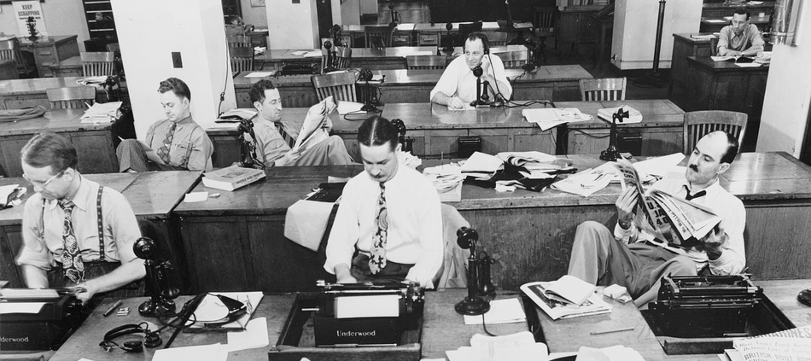
Background
Notes:
The background section is where you set the stage for the work your project did on the objective.

Slide 32
County A is situated on the Southern Coast of California. The county lies 106 miles south of San Filepe and 241 miles north of Juarez. It covers a land area of 3,322 square miles and had an estimated population of 408,238 people in 2008. The county has 12 incorporated cities. The county is bordered in the north by Feliz County, the west by the Pacific Ocean, the south by Santa Lucia County, and the east by Rodriquez and San Juan Counties.
The Gracias Valley is at the county’s geographic heart. Known as “the salad bowl of the world”, the valley lies between the Alto and Azure Mountain ranges and runs almost the entire length of the county. It is the agricultural center of County and is one of the nation’s major vegetable producing areas. The city of Mesa Grande, located in the northern part of the Valley serves as the county seat and is the largest city in the county with a population of 150,898 residents, a 5.8 increase from 2000.
The Peninsula, comprised of four small cities, is the other population center of the county. Salt harvesting and kelp research are the major industries in the coastal areas. The rest of County is essentially rural and characterized by agricultural land and mountains. The small cities of Fruita, Orangia, Ananas and Pina stretch out south of Tapas along U.S. Highway 44 in the area known as South County. The small communities of Birria, Enchilada and Torta form what is called North County. There are many farming and coastal communities throughout the county that are unincorporated. Approximately 24.9% of the population of County lives in the unincorporated areas.
Notes:
Now writing the background section sounds pretty straightforward, but in the past reviewers found that many reports included a lot of extraneous information that didn’t really provide much RELEVANT context for the objective and lacked the information that really mattered. We often saw a lot of description like this which looks like text straight out of the county profile– stating the location, square miles, population size, major economic activities, etc. Now depending on the objective language, some of this information could have a bearing on the work undertaken…IF the objective was addressing the tobacco use habits of laborers living in small farming communities perhaps. But what we don’t see here is anything about tobacco norms, political sentiment about regulation, history of the issue in this region. Information that provides a rationale for why the objective was important to tackle.

Slide 33
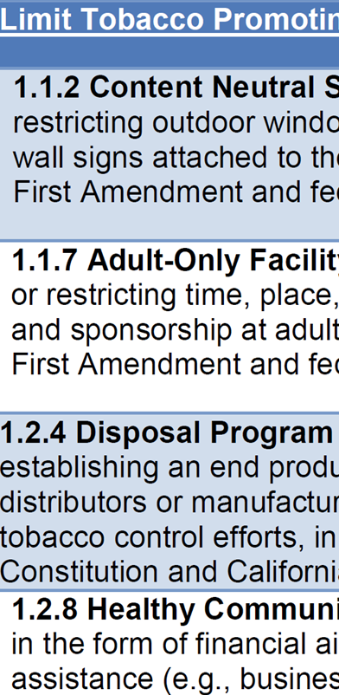
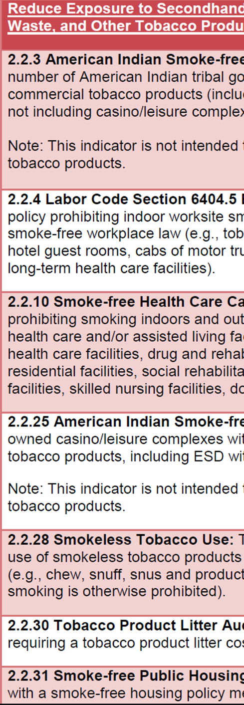
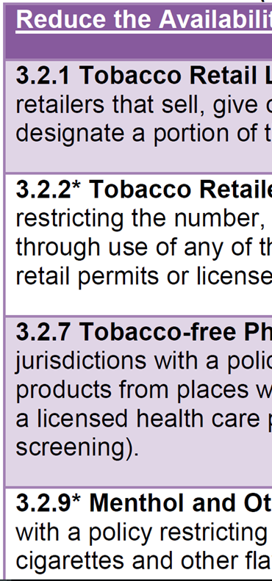
Why this?
Notes:
It should explain why—out of all the possible objectives you COULD have worked on—why did your project select this one? And why tackle it in this manner (as stated in the objective language). In a paragraph or two, describe the need or scope of the problem in the target jurisdiction. Describe the conditions surrounding the issue.

Slide 34
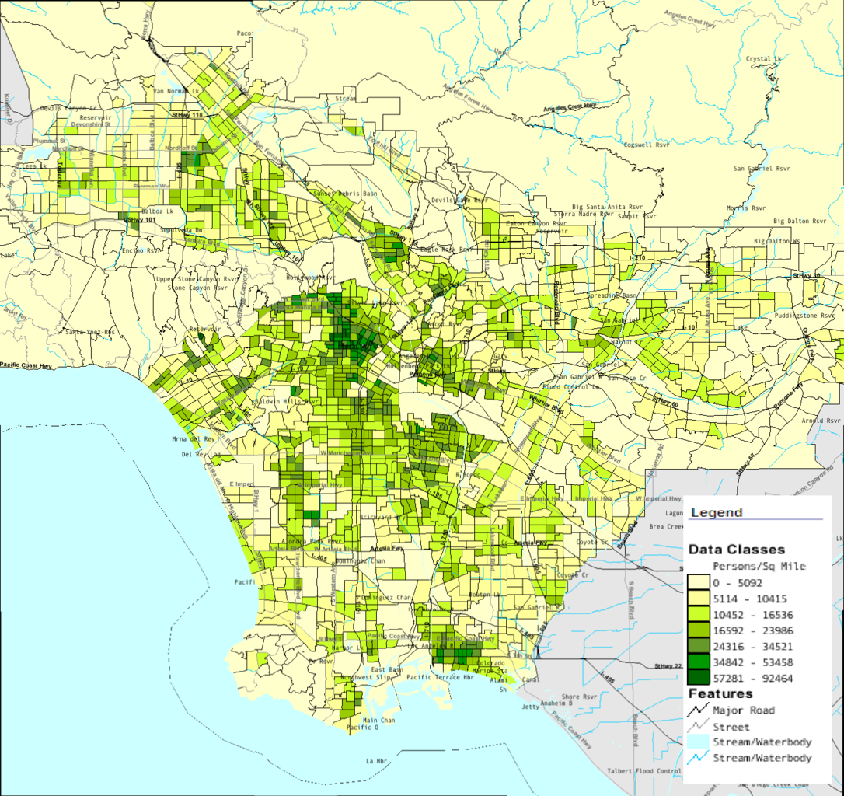
Why here?
Notes:
Why was this objective a need in the target jurisdiction mentioned in the objective? Was there a higher than normal rate of tobacco use, youth uptake, illegal sales rate, or health disparities across different populations in the community? Include any relevant evidence that demonstrates the need.

Slide 35
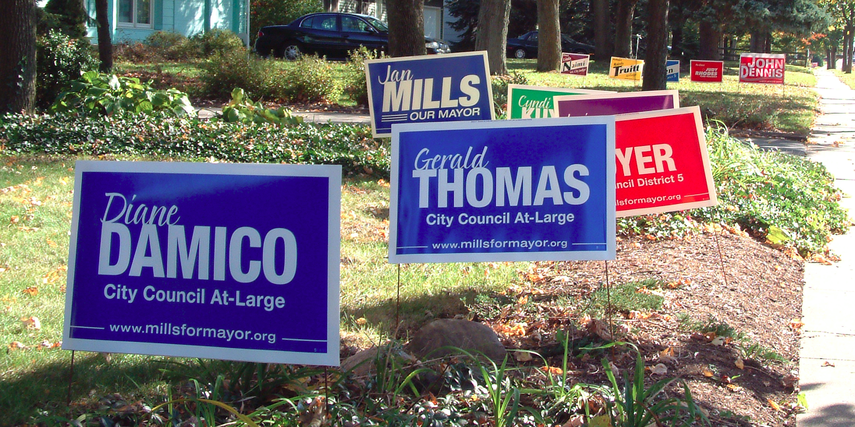
Why now?
Notes:
Address why this objective was important to address at this point in time. Was there a pressing need that was growing worse? Or was there a political shift or some momentum that you wanted to capitalize on? Describe any work that had been done on this issue in the county up to this point—the aim of past objectives (were they framed differently), tactics tried (did they work?), progress made and obstacles encountered. Also explain what made you think another push would be more successful.

Slide 36
During the CX process, we identified this as a top priority…
Notes:
Mention how the community was involved in setting this objective. Do more than just say that the objective rated highly during the CX process. In 1-2 sentences, what were the factors that made this objective a top priority. Was it high need? Or prime opportunity?
And in case you are wondering why I’m not talking about intervention activities yet, it’s because we’ve moved them to another section of the report which we’ll cover later. For now, we want to give you the opportunity to step into a reviewer’s shoes and score a sample background section.

Slide 37
Read background section (p. 9) and note one shortcoming that you noticed. Type this into the chatbox.
Notes:
Keeping the information we just covered in mind, we want to give you an opportunity to step into a reviewer’s shoes. In your handouts, turn to pages 8-9. These are the criteria the background section should meet. (RK summarize the 3 measures) We don’t have time to go through a complete scoring process, but we’d like you to read the the background excerpt (p. 9) and identify one shortcoming that you see with this example and type it in the chatbox. When you’re done, we’ll come back together and share comments. You have about 5 minutes to read and comment.

Slide 38
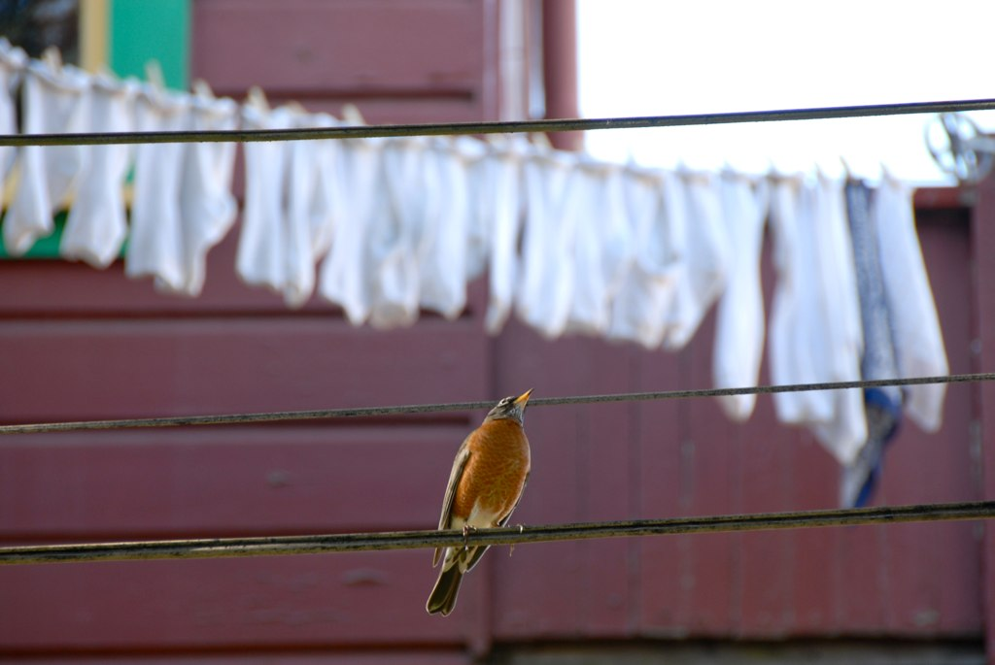
What info was missing?
What info seemed irrelevant?
Notes:
OK let’s see what shortcomings you noticed. (READ comments)
So a well-written background provides a clear rationale for work on the objective and provided RELEVANT description about the need, norms, context and demographics.
This sample….
What about the second measure– indicates the role the community played in assessing needs and selecting the objective? Scores 4, 3, 2,1. Reasons for scores
And last—describes any previous work done on the issue. Scores
So did this exercise give you some ideas about how you might improve the way your write the background section of your reports?

Slide 39
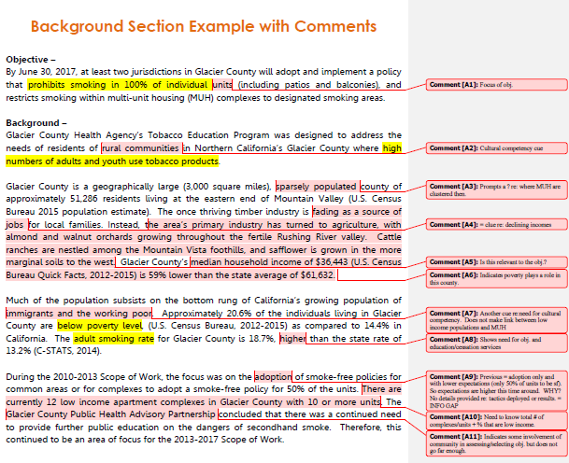
Notes:
OK so this write up left some gaps and unanswered questions, RIGHT?
It doesn’t go far enough in linking the high use and poverty rates to the need for this objective
Contains some unnecessary detail and lacks some relevant context for the objective (# cities, where MUH is located, # complexes/units, % of population living in MUH, community norms re:tobacco in the county
Doesn’t go far enough in explaining community role in selecting the objective
Doesn’t provide any details re: past work on this issue, tactics used, with what results, what still needs to be done
For an example of how it could be written up better, see answer key packet (mention?)

Slide 40
Evaluation Methods and Design
Notes:
The evaluation methods and design section is fairly similar to how it was written before, but with one or two notable changes.

Slide 41
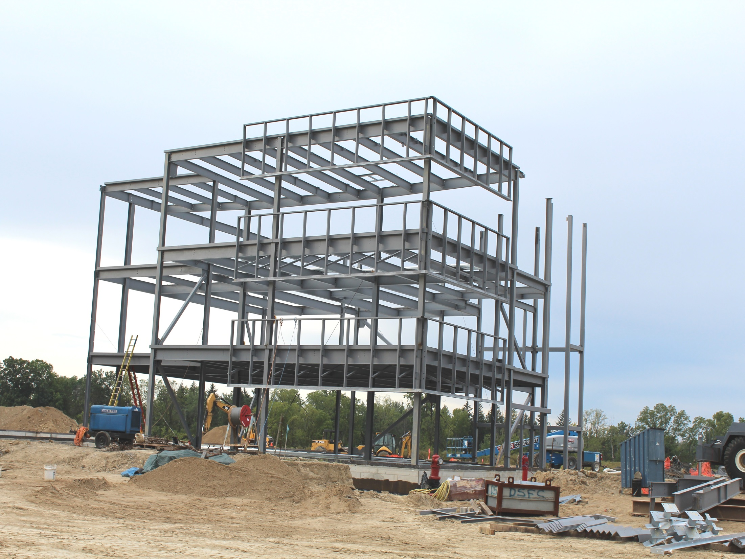
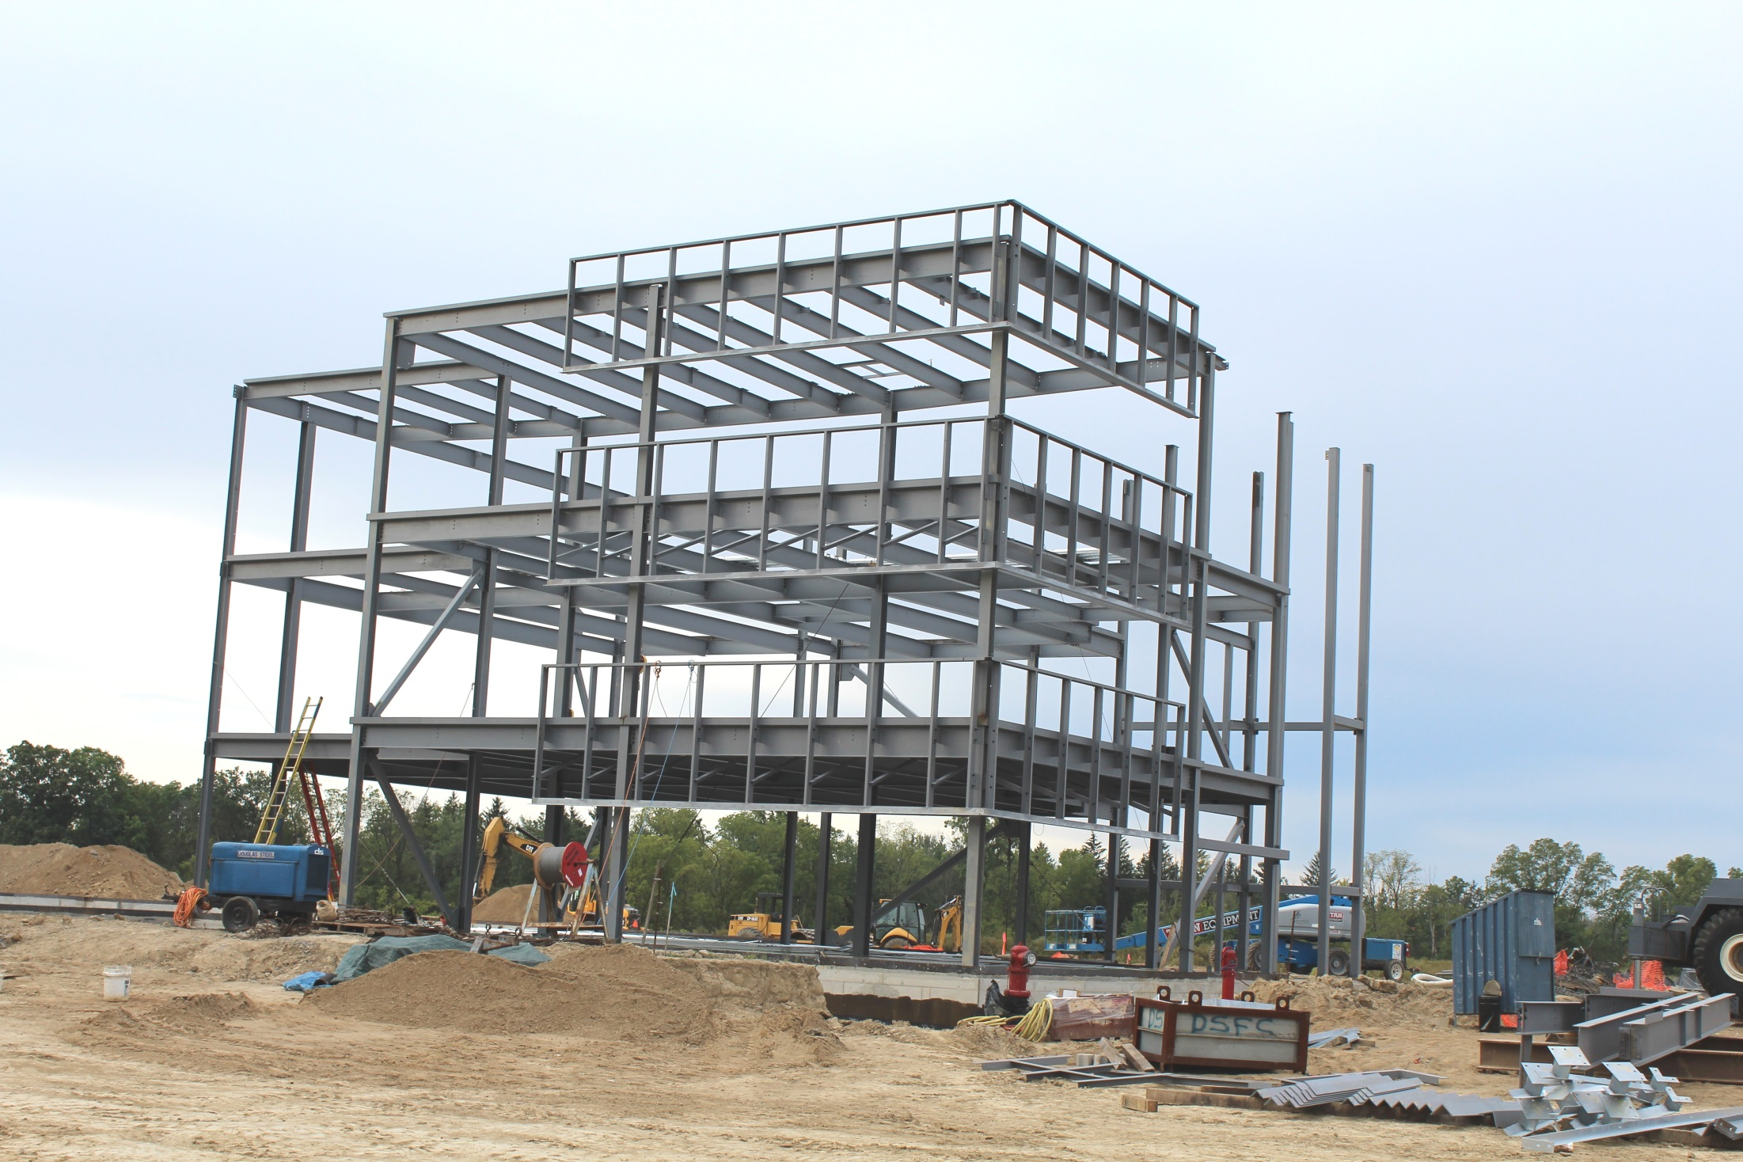
Overall Construction: Outcome and Process
Notes:
The purpose of this section is to provide a framework that explains how evaluation supported the objective. Start out by describing the overall design of the evaluation. This refers mainly to whether or not the evaluation included process and/or outcome measures and how these informed or supported the project. (This is all laid out in your workplan, so have this nearby when writing this section.)
For example, an objective to adopt and implement a smoke-free parks policy would rely on both process and outcome evaluation activities – process measures to inform strategies and build momentum along the way, and an outcome measure to assess whether the policy was being implemented. In most cases the outcome evaluation will use a pre-/post design, meaning you measured before and after the intervention to document change. All objectives use process evaluation activities, so state this here, for example: Process evaluation was conducted to move the project forward.”
Providing this framework, gives readers a sense of HOW evaluation was used and whether it all makes sense. This outline/overview is like one paragraph long—you don’t need to go in to a lot of detail.

Slide 42
Notes:
Something that is new is a table which clearly and succinctly lists your key evaluation activities, their purpose, description of each sample, the instrument source, the analysis method, and the timing/waves. Separate these by outcome and process measures. This is a useful addition because it helps the reader to follow your report. In the past, we often found some essential pieces of the puzzle was missing from many reports, making it hard to understand when an evaluation activity had occurred or what the purpose of the activity was, etc. TCEC has created a template of this table for you to use, but you can also easily produce your own.
You don’t need to include EVERY eval activity in your plan, just the main ones that proved to be significant in moving the work forward or documenting the outcome.

Slide 43
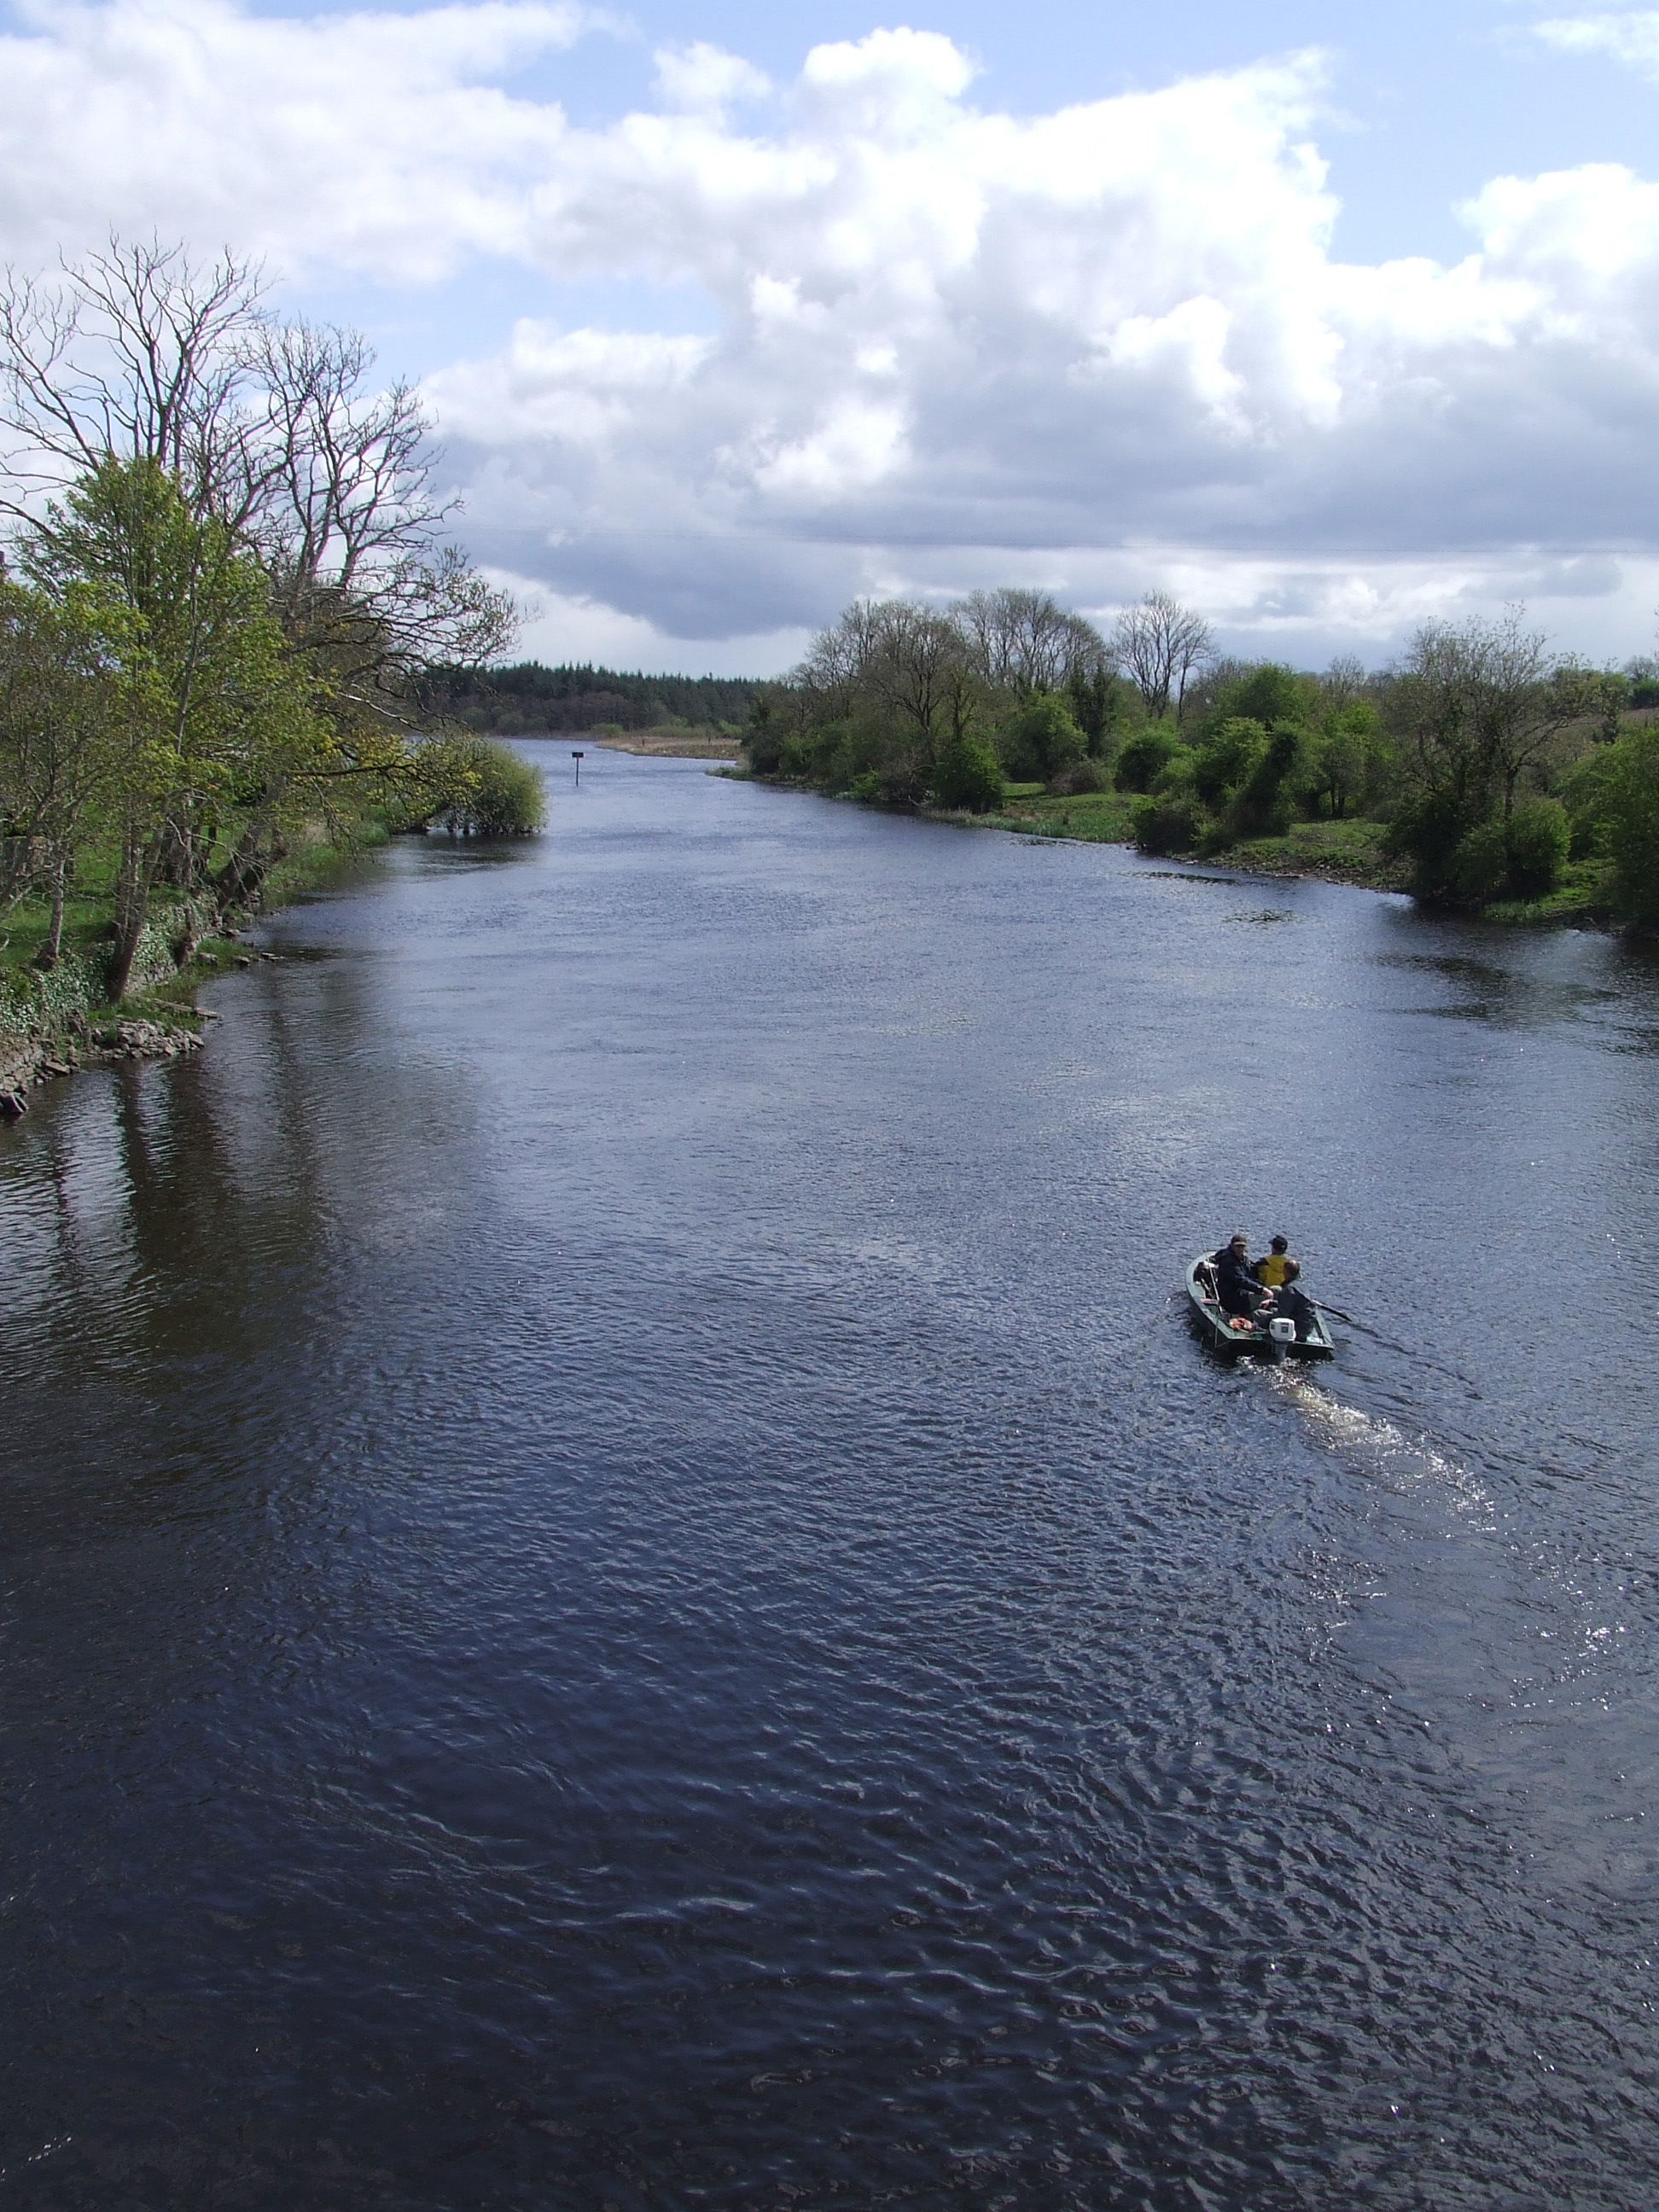
Methods and Design Section Narrative Flow
Outcome measure
Process measures
Data quality
Data analysis (overall qualitative/quantitative)
Limitations
Notes:
Next, there is a narrative section to briefly state how key evaluation activities supported the objective. Also in 1-2 sentences explain how data quality was ensured by describing how data collectors were trained. (more detail can go in the appendix). Recap how data were analyzed. You do not need to state this for each activity individually (as in the past). In most cases this could be a sentence like: “QUANTitative data were analyzed using descriptive statistics, and QUALitative data were analyzed through content analysis.” If you conducted any additional statistical analysis, you can also specify this here. Lastly, describe any limitations to your evaluation design or data collection. For example, the sample size of the HSHC public intercept survey may have been too small or non-representative of the general population because of its convenience sampling methodology. You’ll go into more detail about each activity, how it was carried out, and how the project used the data, in the Implementation and Results section.

Slide 44
Notes:
https://www.breakthroughmarketingsecrets.com/wp-content/uploads/2016/05/the-story.jpg
So far, the previous reports sections were laying the ground work for your project’s story – stating the objective and end result, describing the need for the objective, and outlining the evaluation approach to the work. Where the story really begins to unfold is this main section of the report…

Slide 45
Integrate
Notes:
…the Implementation and Results section. This is where the primary action of your story will be told.
In the past you reported the intervention activities in the background section and then the evaluation activities in the Evaluation Design and Evaluation Results sections. This reinforced the misperception that evaluation is just an add-on, and not something that should inform project activities along the way. It also made for a disjointed story since many of the pieces and timelines did not match up or flow coherently

Slide 46
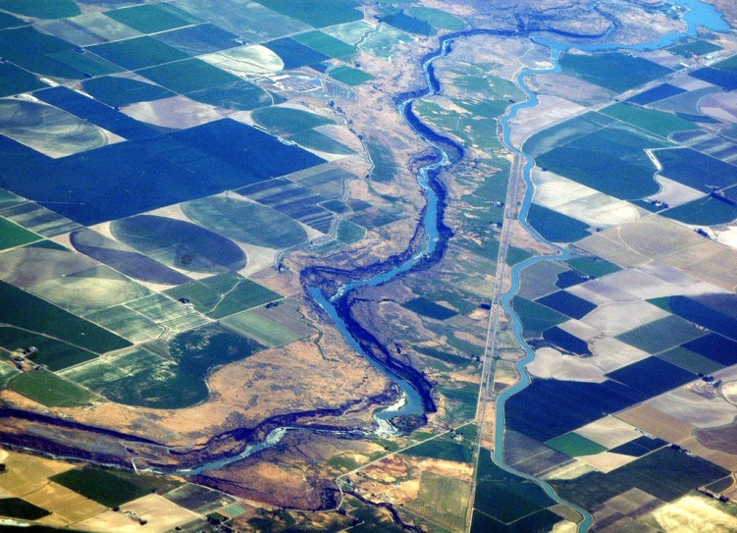
Holistic view
Notes:
Your story of activities and their results should flow together to provide a holistic view where it’s easy to see how each of the various pieces fitted together to support the work.

Slide 47
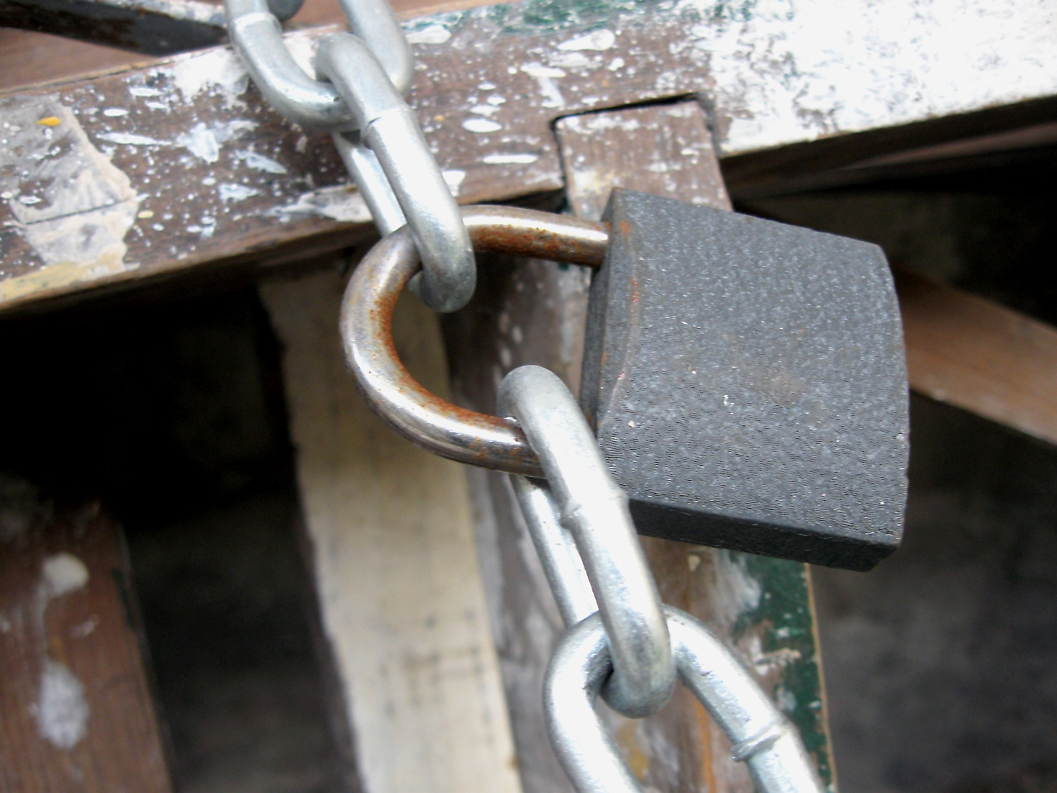
Make linkages
Notes:
The section should show the connection between activities. Discuss how evaluation supported or informed the intervention but also how intervention activities built upon each other as well. Do this by describing the utility of each activity. What did you learn from it? How did it inform or support activities that followed after? For example, how did meetings or info sessions with one group of stakeholders help you frame your information packets or media messaging later on?

Slide 48
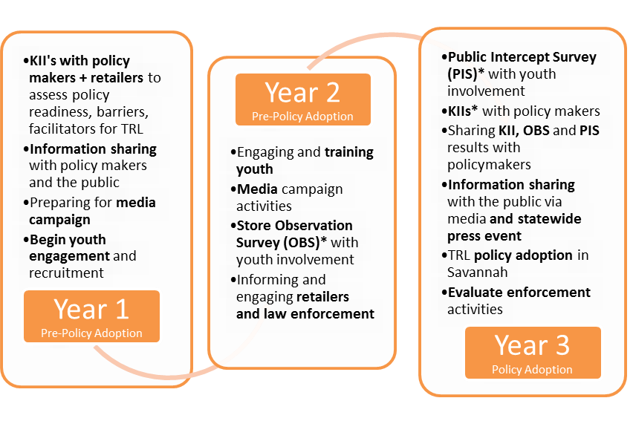
Timeline of Activities
Notes:
One element that can help readers follow the chronology is a timeline of key activities. TCEC has created a template that you can use to do this. You don’t need to report on every activity in your plan, just the most essential ones – those that served as stepping stones in your project’s progress toward the objective. These could be activities that produced positive outcomes like letters of support or willing volunteers, but they could also be activities where roadblocks or opposition was encountered but this produced some valuable lessons learned such as retailer concerns or vape shop opposition tactics. Report on any activity that supported or informed activities that followed or that demonstrated project outcomes. Less essential activities can be reported in the Appendix or not at all. An evaluation report differs from a progress report in that way.

Slide 49
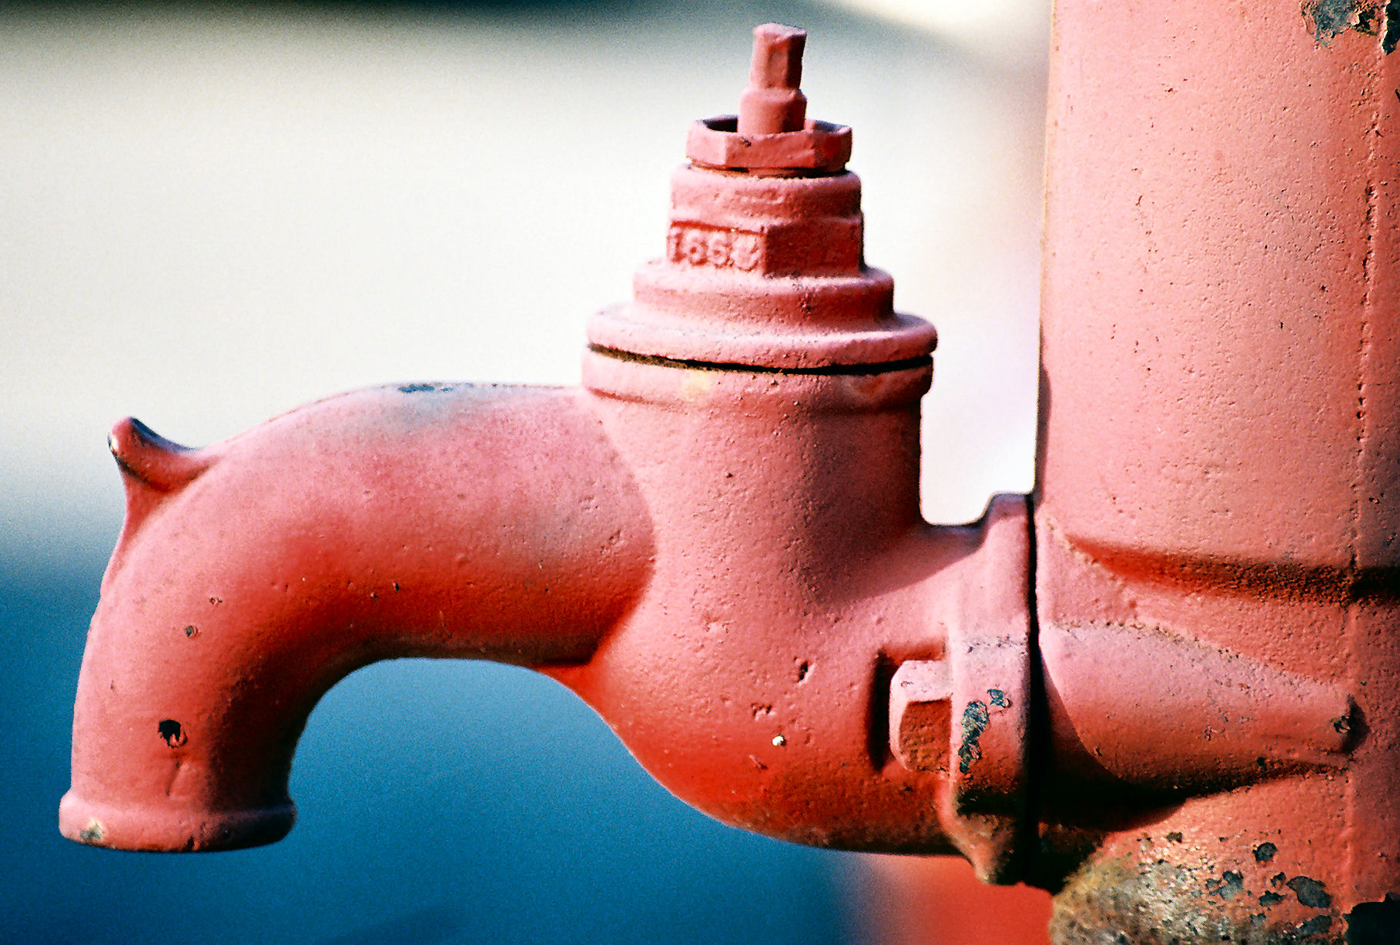
S
P
O
U
T
Notes:
Specifically, what information should you report? I created a little acronym to summarize what to include. To create the right flow of detail that includes just what is needed without overwhelming, think of SPOUT.

Slide 50
Specify what happened
Purpose of the activity
Outcomes
UTility
Notes:
SPOUT stands for:
S Specify what happened – what did the activity entail, who did it target, when and where did it take place, what information/tactics were used? How were participants approached and recruited? Materials developed? Samples derived?
P What was its purpose – what did the project hope would happen as a result?
O What outcomes resulted? For intervention activities, this could be number of people attending, comments they made or actions they took. For evaluation activities this could be results from data collection activities in the form of narrative as well as strategic data visualizations, when warranted. Be sure to provide interpretation—or sense-making—along with the results to communicate what meaning they had for the project.
UT Explain how activities supported or informed the project progress or outcome. This is where making linkages between activities comes in. If possible, show how one activity served as the stepping stone to those that followed. This is true for intervention activities as well as evaluation activities. If for some reason an activity takes place later than planned and therefore doesn’t serve its intended function, just explain the circumstances for why that was.

Slide 51
Cultural Competency
Notes:
As you describe activities, be sure to articulate how your project applied culturally competent practices into your activities. In other words, what tactics did you use to tailor your community outreach, materials development, education, data collection, analysis, sense-making and reporting activities to different audiences, stakeholders and populations in the community? These strategies often make all the difference in the success of your work, and documenting what you tried will be very valuable.

Slide 52
RESULTS
In May 2015, the project invited local retailers to an informational forum on healthy retailing. Six retailers, two from Savannah and four from Serengeti, attended. Although this was far fewer participants than we hoped, the gathering still produced some useful outcomes. In discussions, the retailers said the only way to create a level playing field for those who refused to sell tobacco products to minors was for a licensing ordinance to be uniformly enforced. A TRL was the way to ensure that those who did not obey would suffer consequences. Four of the retailers signed a letter of support for a TRL ordinance. ACTCP included this information in a summary report to the city council members.
Notes:
Here’s an example of how you might write up an intervention activity. The results are a highlighted in red.

Slide 53
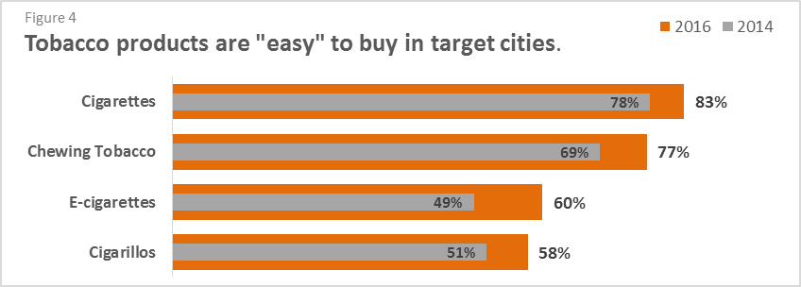
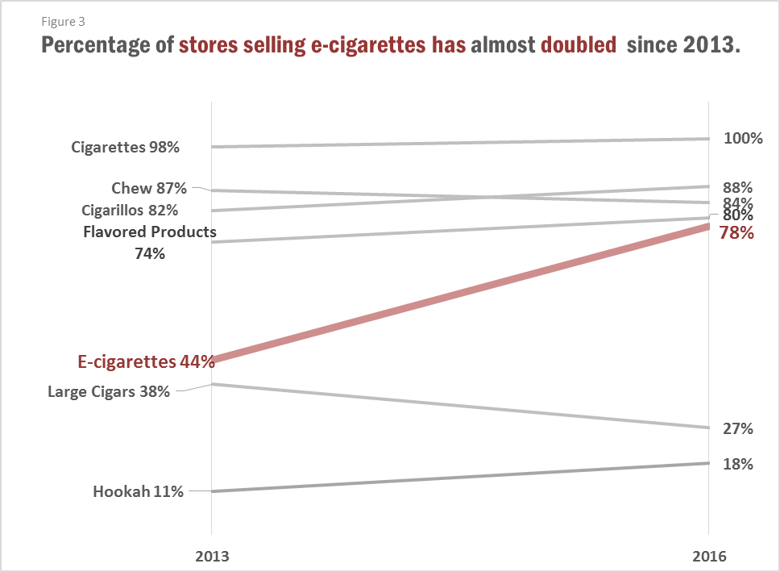
RESULTS
Notes:
Here are some examples of ways evaluation data can be communicated. OF course each of these would be accompanied by a narrative description that interpreted the meaning or importance of these findings to the objective.

Slide 54
RESULTS
Notes:
Be sure to report on negative as well as positive outcomes. Often the most valuable insights come from understanding why there was opposition or why some activity didn’t work as planned.

Slide 55
Too much or too little detail?
Notes:
How much detail is necessary to include in the report? After all, the evaluation activity write ups of each data collection activity should have already been submitted in your progress reports. It’s there that every data point should be written up. But that level of detail is not necessary for an evaluation report, at least not in the body of the Implementation and Results section. Just include enough detail so readers can draw practical strategies from the description but don’t go overboard. Beyond that, more detail can be reported in the Appendix if desired.

Slide 56
Implementation and Results
Read the section and score it according to the six measures on the rubric. Also note specific feedback you could provide the authors.
Notes:
We are going to give you a little homework to do on your own before tomorrow.
If you will turn to page 11 of Training Packet 1 and you’ll see Worksheet D that looks something like this. And pages 12-16 is a sample Implementation and Results section that you are to read and score on these six measures (READ). You can see that the new scoring rubric uses a 5 point scale (1-4) instead of a 3 point scale (0-2). So keeping the information we just covered in mind, read and score this section. As you do, make constructive comments about what was done well and where any gaps or questions remained for you. When we reconvene tomorrow morning, we’ll share scores and comments.

Slide 57
Agenda
Day 1
Welcome!
Ch Ch ch Changes
Setting the Stage
Aim and Outcome
Background
Evaluation Methods and Design
Connecting Intervention & Evaluation
Notes:
So just to recap, here are the main concepts we have covered so far… Aim and Outcome
Background
Evaluation Methods and Design
Tomorrow we will resume with Implementation and Results since we just got a little taste today. We’ll also talk about Strategies for Writing, and the Conclusions and Recommendations section

Slide 58
Questions?
http://tobaccoeval.ucdavis.edu
tobaccoeval@ucdavis.edu
530.752.9951
TCEC is the statewide technical assistance provider on evaluation for all Prop. 99-funded projects in California
Notes:
If there’s time…if not, we’ll take questions at the start of tomorrow

Slide 59
Tell Your Story 3.0:
New Final Evaluation Report Guidelines
May 10-11, 2017
10:00-11:30 a.m.
Notes:
While you’re waiting, feel free to use the chatbox to type in questions that you may have from yesterday.

Slide 60
Agenda (cont.)
Day 2
Questions from Yesterday?
Connecting Intervention & Evaluation
Implementation and Results, Strategies for Writing
Making it Useful
Conclusions and Recommendations, Avoiding Landmines, “Rap” Up
Notes:
Today, we’ll start with your questions from yesterday. If you have any others, please type it into the chatbox.
Then we’re going to jump right in and talk about the really meaty part of the report and another meaningful change to TYS, which is the implementation and results section, where intervention and evaluation activities and connected and reported on together.
Then we’ll go into the Conclusions and Recommendations section, followed by a review, avoiding landmines, and if we have time, a rap up video.
So I will hand it over to . For the implementation and results section

Slide 61
Questions?
http://tobaccoeval.ucdavis.edu
tobaccoeval@ucdavis.edu
530.752.9951
TCEC is the statewide technical assistance provider on evaluation for all Prop. 99-funded projects in California
Notes:
Are there any questions so far?

Slide 62
Themes
Utility
Connectivity
Cultural competence

Slide 63
S P O U T
Specify what happened
Purpose of the activity
Outcomes
UTility

Slide 64
The New TYS
Overview
What’s New
Tools
Space For Notes
Notes:
Ask if they want to share their major take aways
NEW:
Aim & Outcome = state objective and end result up-front
Background =
Evaluation Methods and Design
1 table on overview of evaluation activities
Implementation and Results section
1 figure for timeline of key intervention and evaluation activities
Intervention and evaluation activities combined in narrative Only major evaluation activities in text; others in appendix.
Graphs used sparingly with good visuals
It’s a story!
Packet 2 has the answer keys to all of the worksheets, including more details on the differences by section with this new iteration.
So take a look at the answer key for a ton of information. And take a look – if you have other important points to add, please let us know so we can include that in our resources.
If there are no other questions about Day1…(wait)…I’ll now hand it off to

Slide 65
Read the section and score it according to the six measures on the rubric. Also note specific feedback you could provide the authors.
Notes:
Hopefully you all had time yesterday to read and score our sample Implementation and Results section on these six measures.

Slide 66
Rating Scale
Notes:
You perhaps noticed that the new scoring rubric uses a 5 point scale (1-4) instead of a 3 point scale (0-2) that was used in the past. This will allow reviewers to give partial credit but still make important distinctions between a section that is exemplary or very well written and those that lack either clarity or completeness..

Slide 67
How well could you follow the story?
Were there any gaps?
Were results interpreted?
Notes:
OK let’s go thru the rubric and see how everyone scored these measures.
1.
2.
3.
4.
5.
6.
So did this exercise give you some ideas about how to go about writing the Implementation and Results section of your reports?

Slide 68
Connecting Intervention & Evaluation Activities
Notes:
Strategies for Writing – Connecting Intervention & Evaluation Activities
In the previous section we discussed why intervention and evaluation activities are reported together and how this is different than activity write-ups. Now we are going to talk about how you can approach the writing/reporting process.
Up to this point, writing the Final Evaluation Report could essentially be a one-person activity. Often, the evaluator wrote the whole final evaluation report, doing their magic and producing a summary of the intervention activities and evaluation activities. Or sometimes, writing was shared between the project director and the evaluator.

Slide 69
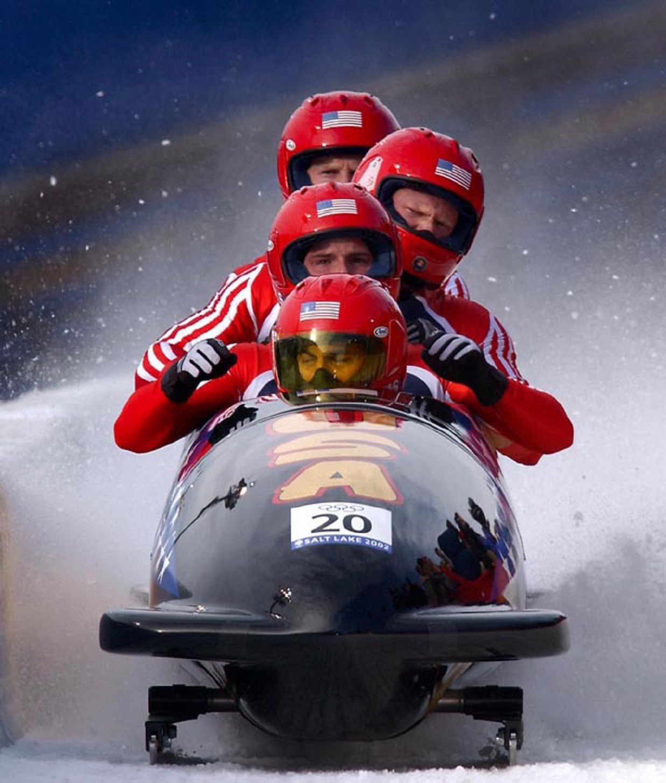
Connecting Intervention & Evaluation Activities
Notes:
As you learned in the previous sections, the new Tell Your Story Guidelines have changed the sport. For that reason, you won’t be summarizing a list of intervention activities that the project director could write as has been done in the past. Nor will there be a detailed emphasis on evaluation methodology and results that only the evaluator can do. Instead, there is a chronology of intervention and activities woven together. This means, you will have to figure out a new way to complete the final evaluation report document.

Slide 70
Connecting Intervention & Evaluation Activities
Connecting Intervention & Evaluation Activities
Notes:
Strategies for Writing – Connecting Intervention & Evaluation Activities
So, let’s talk strategy.
The first part of writing includes gathering up the materials. For example, you will need to get your 3-year plan, progress reports, evaluation activity writes ups and notes, and, of course, the new TYS Guidelines.

Slide 71
Connecting Intervention & Evaluation Activities
Connecting Intervention & Evaluation Activities
Notes:
Then you will have to pull together the chronology, which means a conversation will need to happen between the evaluator and the project staff to identify KEY intervention and evaluation activities, as well as successes and challenges during the 3 year SOW. Here you are working together to conduct a review and look back over the 3-year scope of work to determine the sequence of events, as well as identify the key elements to include in the final evaluation report.

Slide 72
Connecting Intervention& Evaluation Activities 1st Step
Year 1
1 Policy Amended
Gather information regarding Paradise and Chico policymakers proceedings and voting record (July 2014)
Year 2
2 Policies Amended
Gather information regarding Butte County policymakers proceedings and voting record (July 2015)
Year 3
X
Media campaign activities
Begin youth engagement and recruitment
Policy maker KIIs to assess policy readiness, barriers, facilitators for ENDDs (November 2014)
Information sharing with policy makers and the public
ENDDs policy adoption in Paradise (Date?)
Public Intercept Survey (PIS) in Chico (May 2015)
ENDDs policy adoption in Chico (Date?)
Media campaign activities
Presentation to BOS with youth involvement
ENDDs policy adoption in unincorporated areas of the county (Date?)
Informing and engaging the public in Paradise, Chico and Butte County
Public Intercept Survey (PIS) in Paradise (September 2014)
Engaging and training youth
What else ?
Notes:
As the first step, you will need to populate the DataViz Chronology.
The Project Director or the Evaluator can prepopulate the DataViz Chronology tool in advance of a joint meeting. This way, you can focus together on clarifying the information you have and identifying what’s missing. You can confirm the timing of KEY events and focus your discussion on what was effective, where there were hiccups and what that means for your project moving forward.
As I mentioned, this is one possible approach. You may have other ideas how to build this chronology.
As mentioned yesterday, this is available as a template that you can also use in your report. It’s readily available in Word, so we don’t take credit for this, but we do have a file to make it a little easier for you to use.

Slide 73
Connecting Intervention& Evaluation Activities Group Discussion – Dial *7 to unmute
Who needs to be involved in the writing process?
What strategies could be used to integrate intervention with evaluation activities?
What pieces of information need to be included?
Notes:
Again, during the training we had an activity here, but we’ll discuss as a larger group instead.
Based on what you’ve learned thus far, who needs to be involved in the writing process? And, who will write what pieces?
What pieces of information need to be included? And how will you get ready for the actual writing?
And what strategies could be used to integrate intervention with evaluation activities? Is there a strategy that you would like to try?
Either in the chatbox or by dialing *7 to unmute yourselves
Give us your best idea in response to any of the 3 questions you see on the slide.
Given that the intervention and evaluation activities will now be woven together, rather than reported, separately, how will you manage writing this differently?
How will you get ready for the actual writing?
Who will write what pieces?
What are some other strategies that you want to try?

Slide 74
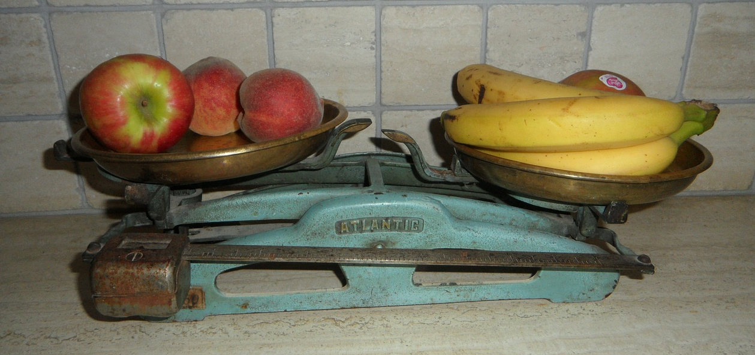
Conclusions:
Assess what worked
Notes:
This slide is not meant to depict what you ate for breakfast, but rather the aspect of weighing, or assessing different tactics—which is what the Conclusions and Recommendations section of the report is all about.

Slide 75
Notes:
As we’ve said all along, a primary purpose of the report is to document the directions your project took in working toward the goal of this objective. For reading flow, begin the section by restating the objective and whether or not it was achieved. Then assess the utility of the activities that proved to be instrumental – either in terms of being an essential foundation for next steps OR because it failed to achieve what you expected.

Slide 76
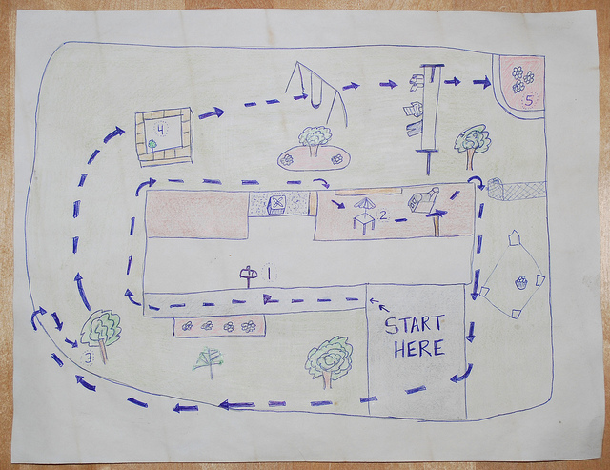
Notes:
A good report creates a roadmap for how your project began at point A and ended up where it did. The conclusions section is where you assess how beneficial the approaches and strategies proved to be in moving toward the objective. It’s the place where you can recommend some shortcuts or alternative routes to avoid roadblocks. The text should include assessment as well as recommendations for how to do things differently. Recommendations should be specific, concrete and offer practical advice to follow. Avoid generic or obvious statements like “Incorporate youth in activities.” Instead, transform this into an Aha! statement like: Policymaker informants said that council members respond better to presentations made by youth than adults because “No one wants to be the jerk who says ‘No’ to a kid. Train a dedicated core of youth volunteers to be spokespersons who can give a personal face to the issue you are asking policymakers to consider.”

Slide 77
Conclusions
Recommendations
Identify which activities and tactics proved most crucial to the effort
Assess what worked or didn’t work well and explain why
What would you do again?
What would you do differently?
What strategies or activities would you recommend to others?
Notes:
Because people at our in person training struggled a bit to differentiate between assessment statements/conclusions vs. recommendations, here is a summary of the key differences or roles each component of this section plays.
In this section, the project should weigh or assess the impact or effectiveness of key activities. Draw some conclusions about the value of key activities/tactics/strategies for this objective– which ones turned out to be useful in the effort toward the objective? Which less so? Which worked really well? Which ones failed? Explain the factors/reasons for these successes or failures?
Next, what recommendations could the project make for next time or for others to follow. What specific advice could you provide about which activities or strategies to replicate? What could be done differently/better next time? Make your recommendations as concrete and practical as possible.

Slide 78
Conclusion
Recommendation
The timing of intervention activities is of great importance. Our paid media spots might have been more effective following rather than preceding the regional media event. As it was, our budget could not support sufficient frequency of the ad placement to impress our messaging into public consciousness.
Don’t wait until the end to think re: conclusions & recommendations. Meet with staff regularly to find out what happened, what worked/didn’t, what strategies need to be tweaked, etc. Document results and outcomes and recommendations as they’re happening and keep it in a document for organizational history, so when it comes to writing, it’s all right there.
Notes:
Here are two examples – the first is a conclusion that assesses the effectiveness of their media strategy. It also attempts to explain why this media activity was not as impactful as originally hoped. The second is a recommendation we offer to projects after discussing writing strategies in the training. Notice that it is specific and offers concrete advice for steps for anyone to follow.

Slide 79
Think of a time when…
Notes:
SO let’s practice writing useful, specific, concrete recommendations.
Think of a time when
Don’t wait until the end. Meet with staff regularly to find out what happened, what worked/didn’t, what strategies need to be tweaked, etc. Document results and outcomes and recommendations as they’re happening and keep it in a document for organizational history, so when it comes to writing, it’s all right there.

Slide 80
In 1-3 sentences, write a specific recommendation that would create a road map for other projects to follow.
Notes:
Now write that up in 1-3 sentences as a specific recommendation that someone else could follow. Have a partner review it to see if it is clear and specific enough to be helpful.
DEBRIEF
How easy or difficult was it to write a specific, concrete recommendation? Ask a few people to share. Ask the group, is is specific, concrete, an AHA!?

Slide 81
Upcoming TYS Trainings and Resources
Tell Your Story 3.0 Q/A
May 18th
2:00 – 3:00 p.m.
“Tell Your Story” on the TCEC website: www.tobaccoeval.ucdavis.edu
Analysis & Reporting → Reporting Results → Tell Your Story
Webinar recordings, data visualization templates, sample BER, and many more resources on the way!
Notes:
Packet 2 has the answer keys to all of the worksheets, including more details on the differences by section with this new iteration.
So take a look at the answer key for a ton of information. And take a look – if you have other important points to add, please let us know so we can include that in our resources.

Slide 82
Questions?
http://tobaccoeval.ucdavis.edu
tobaccoeval@ucdavis.edu
530.752.9951
TCEC is the statewide technical assistance provider on evaluation for all Prop. 99-funded projects in California

Slide 83
Post-Training Evaluation
Notes:
Please fill out your evaluations, which will be sent via email. We really want your honest, candid feedback so we can improve future trainings and resources that we develop for you.

