Slide 1
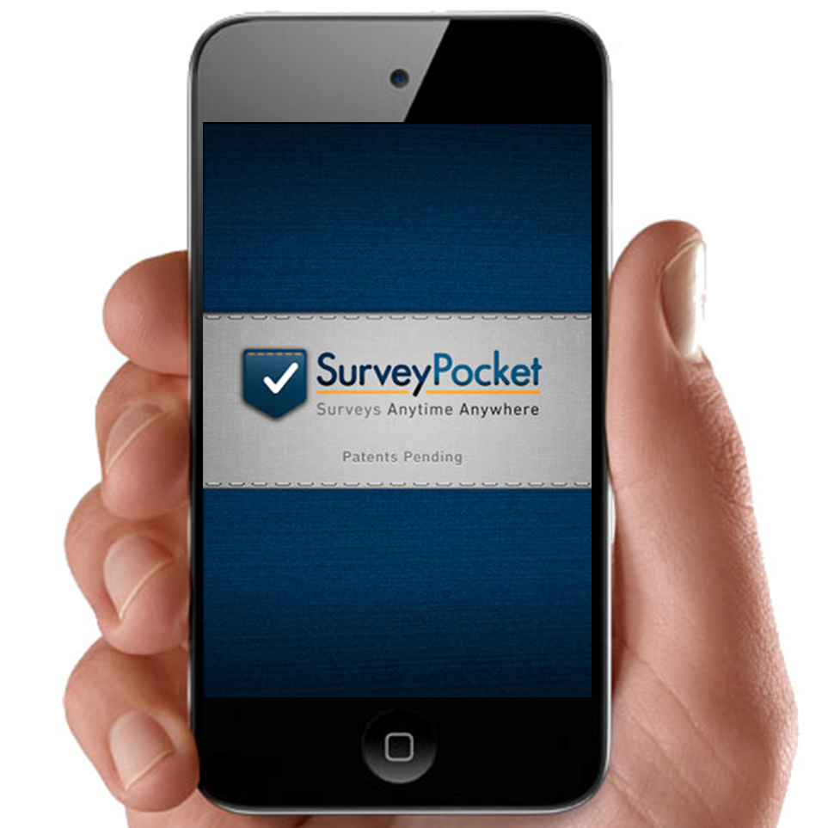
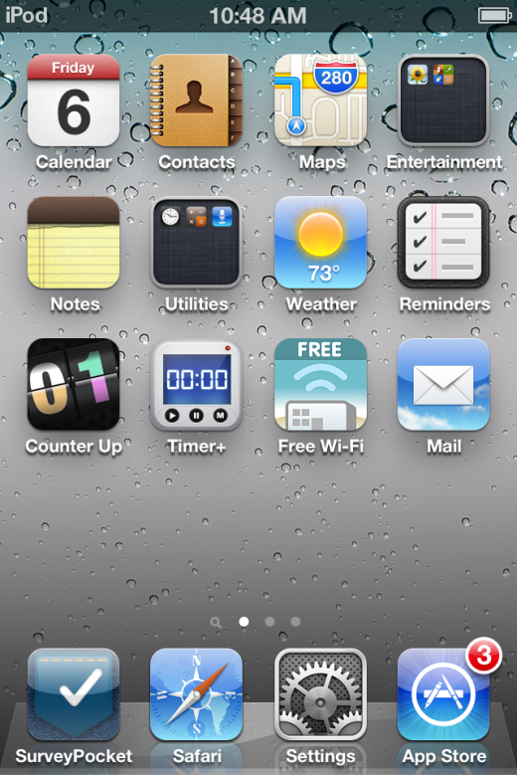
Using the SurveyPocket App
Notes:
As with so many other things, the best way to learn how to use the SurveyPocket app is to PRACTICE, PRACTICE, PRACTICE!
To start a survey, open the SurveyPocket app.

Slide 2
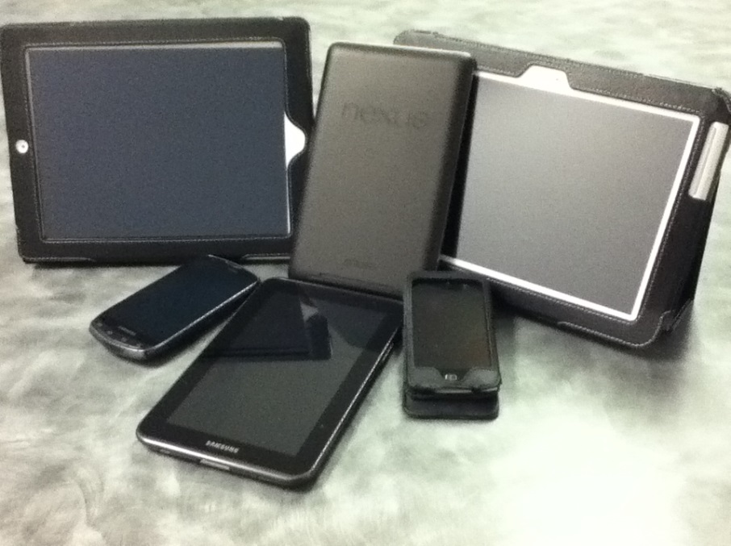
Tips on Using Handheld Devices
Settings
Pop ups:
  “Cancel”
  “Don’t Allow”
  “Ok”
It’s not working!
  Restart app
  Restart device
  Use a spare/back up device
  End for the day
Notes:
SETTINGS = in the settings menu, you can adjust the brightness, sound, and sleep settings. If data collection will occur outside, we recommend making the screen brighter. A brighter screen is easier to read if you’re outside, however, it uses the battery faster. So if your battery is low, you may want to dim the screen. You can also change the sleep settings so that the device doesn’t go to sleep so quickly. Again, the sleep settings help save battery life, so you may want to just set it to a longer sleep time rather than no sleep time.
POP UPS = often, a screen or message may pop up. These messages have many different functions: alert you to charge your device if the battery is low, backup warnings, asking for your AppleID, something about push notifications, location settings, loading videos, and a multitude of other messages. In general, just select “Cancel,” “Don’t Allow,” or “Ok”. You can also try touching outside of the pop up screen so that it goes away. If you’re really concerned about the pop up, let your group leader know.
IT’S NOT WORKING = Here are some tips in case the device doesn’t work the way you expect:
close and open the app (double click device home button, swipe up to close programs, then open the app again)
restart the device (touch and hold the power button, a button will appear, then slide to power off. Touch and hold the power button again until it turns on)
come back to the office get a spare/back up device
end for the day

Slide 3
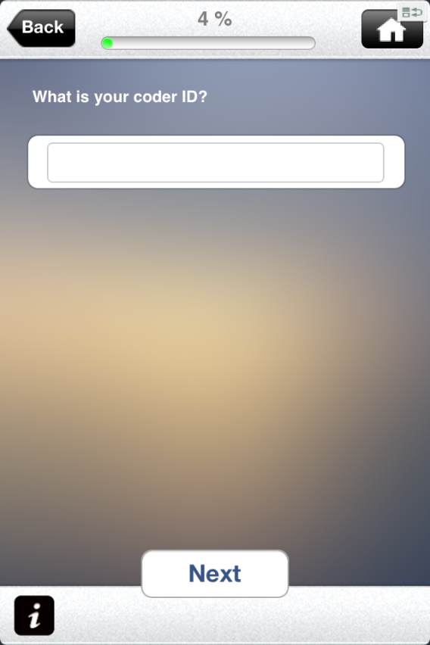
Tips on Using SurveyPocket
Scrolling
“Sweet spot”
Change an answer
Incomplete surveys
Notes:
SCROLLING = Since the handheld device screen is small, all of the words or answer choices may not fit on one screen. So data collectors may need to scroll up and down to view all the content. (Note: For Android devices, data collectors may need to scroll left and right to view all the content)
SWEET SPOT = Selecting an answer in the SurveyPocket app may not be as easy as you’d expect. During practice, try to use the “sweet spot” which is just slightly below the selection you want. It doesn’t help to press harder or more often. Try to be patient and gently tap slightly below the selection. Please be patient, and be sure to practice this before you begin data collection.
CHANGE AN ANSWER = To change an answer, you can just select the new/more accurate answer you want. On certain questions (multiple choice select many) you may need to uncheck the box. To change an answer to a previous question, select the back button on the top left corner of the screen. On small devices, you may need to touch slightly below to select the “Back” button. Again, be sure to practice this before you begin data collection.
INCOMPLETE SURVEYS
If someone does not want to complete the entire survey, that’s ok. You can stop in the middle of a survey by selecting the home button located in the top right corner of the screen. Save it as “Incomplete,” then start a new survey for the next person.

Slide 4
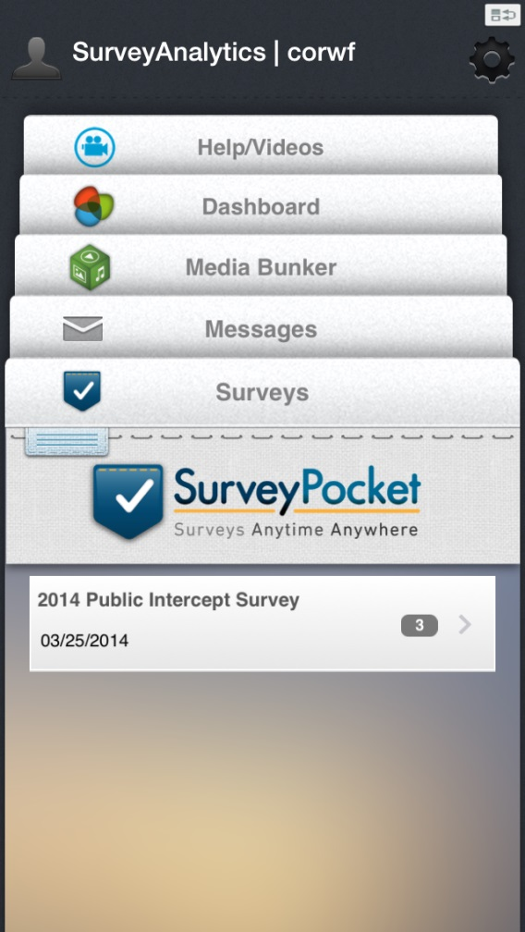
Before the Survey
PRACTICE!
Notes:
Practice all the tips in this presentation until data collectors are comfortable using the devices to collect data.
If you will be collecting data outside, you should practice outside.

Slide 5
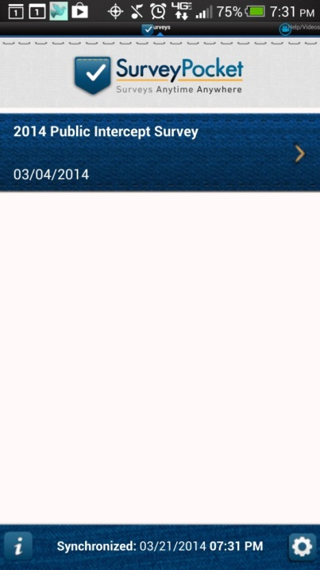
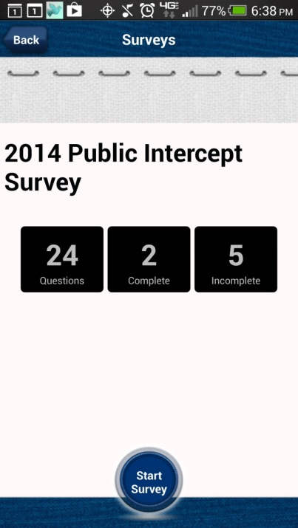
During the Survey
Starting a survey
  Select the correct survey
  Then select “Start Survey”
Back
  To change an answer to a previous question
  Touch slightly below the “Back” button
Home
  To stop a survey
  Save as “Incomplete”
Scrolling
  View all answer choices
Notes:
For your data collectors:
To start a survey, it’ll look like these screen shots. You’ll select “Public Intercept Survey” and then “Start Survey”
Questions will appear on the device. Sometimes, your devices require a bit more patience. The solution is to find the “sweet spot”.
To select an option its best to lightly use your finger directly over the response circle/square
Square answer choices indicate questions that can have multiple answer or check all that apply types of questions.
Circle answer choices indicate questions that only accept one answer. When there’s one of these circle answer choices, the program may automatically advance the page without you having to select “Next” So when we practice in a few moments, you’ll see what it’s like when the page automatically advance.
Another thing that may need a bit more patience is the back button. The best way to use the “Back” button is to lightly touch the area just below it.
If someone does not want to complete the entire survey, that’s ok. You can stop in the middle of a survey by selecting the home button located in the top right corner of the screen. Save it as “Incomplete,” then start a new survey for the next person.
We tried to design the survey so that it fits into one screen. But for some devices, in particular, the smaller Droid devices, may require you to scroll:
Scroll up/down to read full text
Scroll left/right on the first question, which is a matrix question

Slide 6
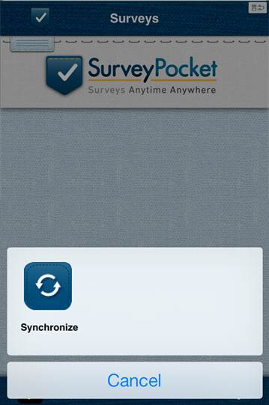
After the Survey
Debrief
Collect and “Sync” all devices
  Requires Wi-Fi to upload results
Ensure data upload
  Access your SurveyAnalytics.com account
Data cleaning and analysis
Notes:
Once back in the office you may want to debrief with your data collectors
any concerns,
comments,
were there any problems with the devices
We recommend to keep a field log, tracking number of surveys and who had what device.
Collect all devices and connect EACH device to Wi-Fi
Then ensure that EACH device is synched to your SurveyAnalytics.com account.
Connect each device to Wi-Fi
Open the SurveyPocket app on EACH device
Synch each device
Once all results have been updated the should not have any red floating numbers on the app logo, and the intro page will not have a number.
When all data has been uploaded/synched
Access your SurveyAnalytics.com account in a web browser
Select the correct survey
Go to Analytics tab
Verify number completed for the correct survey

